Slide 1
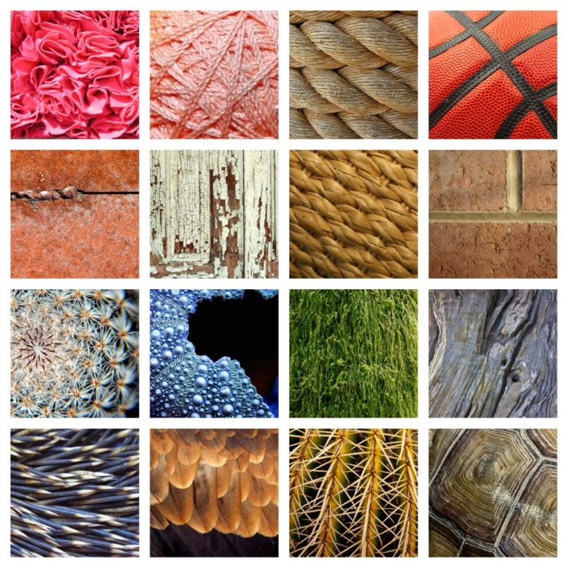
Art 6
Elements of Art Review
Texture
At home review & Art Activities

Slide 2
TEXTURE
What is Texture?
The way something looks or feels.
Texture can be felt with ones hands…
…or, texture can be implied visually.

Slide 3
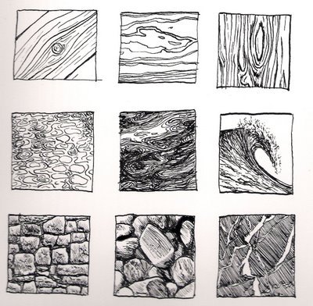
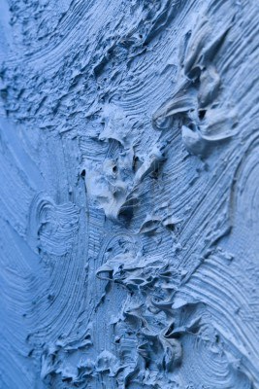
Implied Texture vs. Actual Texture
Drawn texture is a visual suggestion called
Implied Texture
Using paint heavily on a canvas is Actual Texture ( you can feel it)

Slide 4
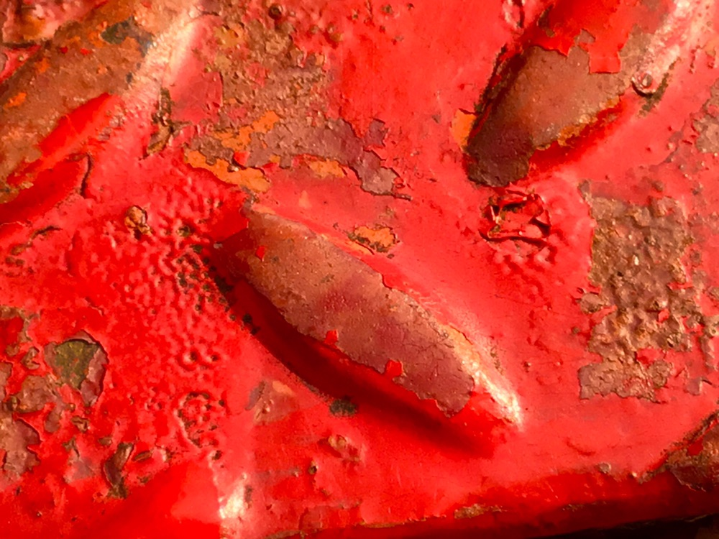
Texture & Photography
A successful texture photograph is one that you can almost feel by looking at it.
How does this photograph communicate a visual texture from your eyes to your brain? How do you think it feels?

Slide 5
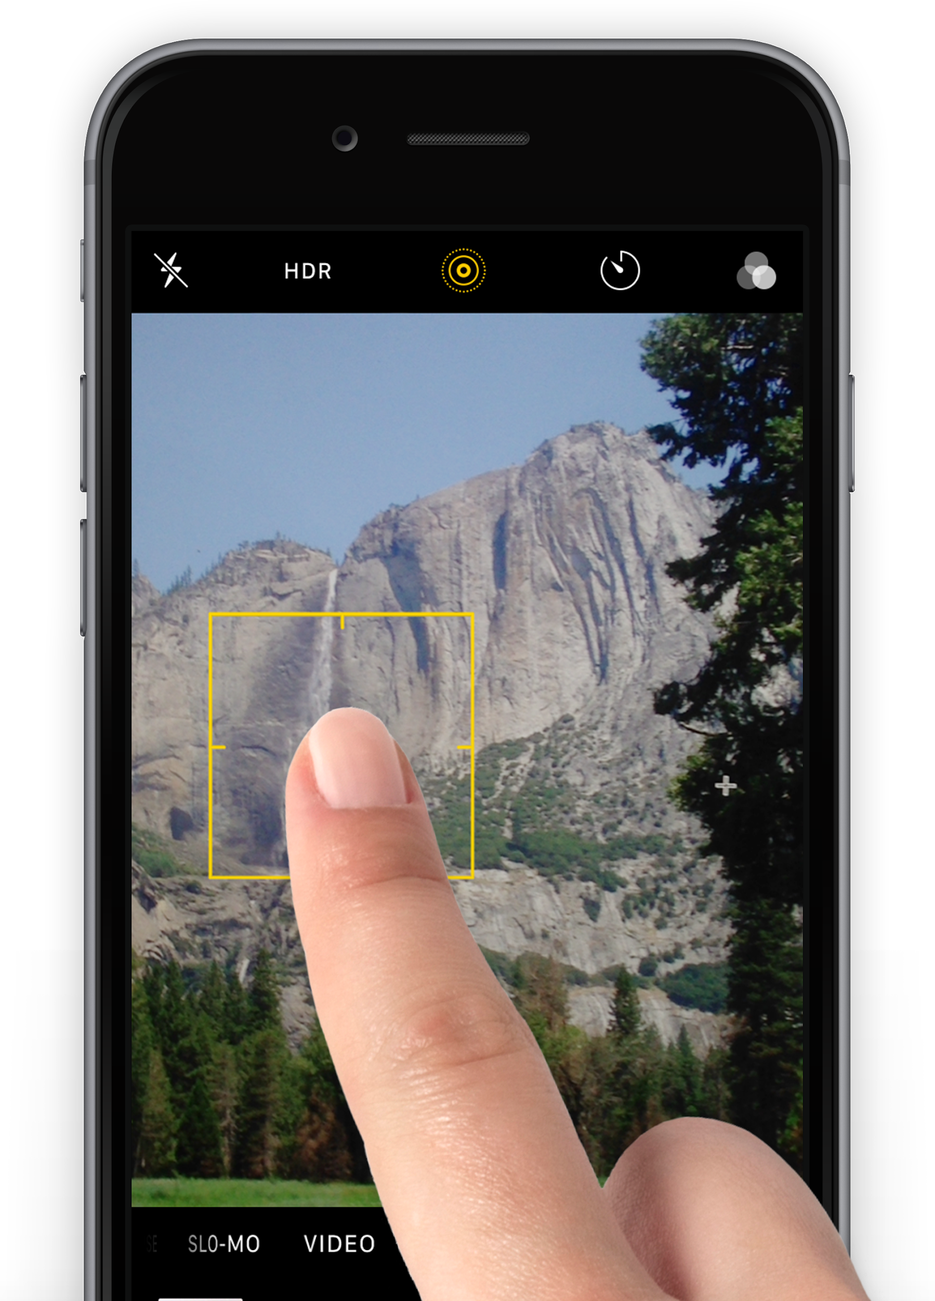
How to photograph Texture: Tap for Focus
When you are in Camera on the ipad or ANY phone, you can Tap on the screen to FOCUS on what you want!
Using Tap to Focus will help your texture pictures be more crisp!

Slide 6
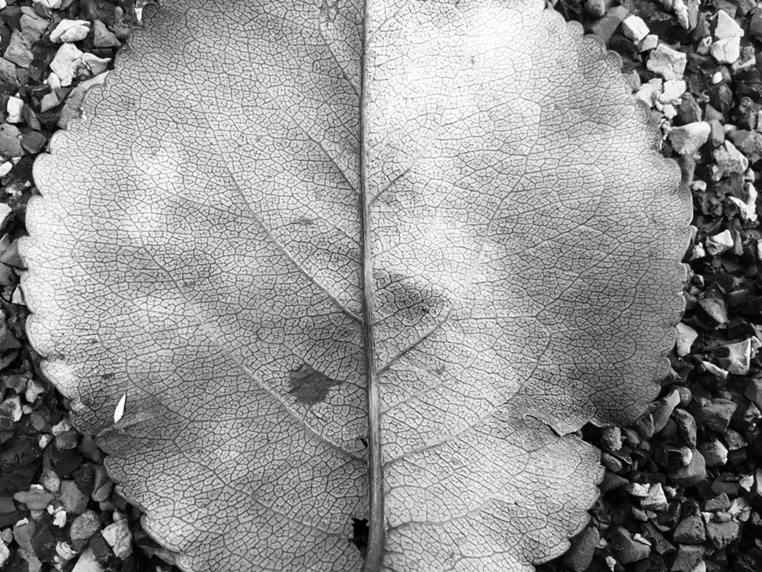
How to photograph Texture: Get close, but not too close!
The texture picture should be ALL about the Texture. Get as close as you can, tap to focus.
If it isn’t focusing, you’re too close! No blurry pictures!

Slide 7
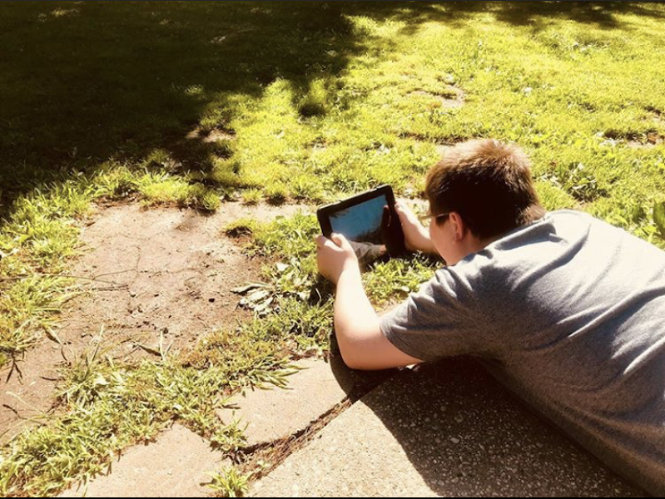
How to photograph Texture: Place ipad/phone on the ground for a worm’s eye view.
Literally place the ipad on a surface like a ground, on grass, or on a tree to capture a worm’s eye view of texture.

Slide 8
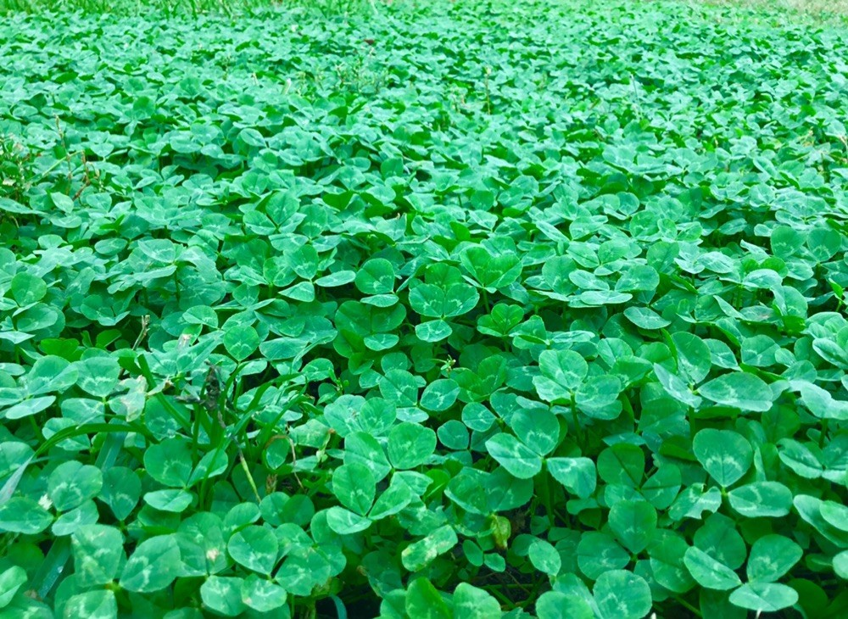
How to photograph Texture: GOOD LIGHTING
Please photograph by a WINDOW or go outside to your backyard/porch.
Lamps are never as bright at actual sunlight.

Slide 9
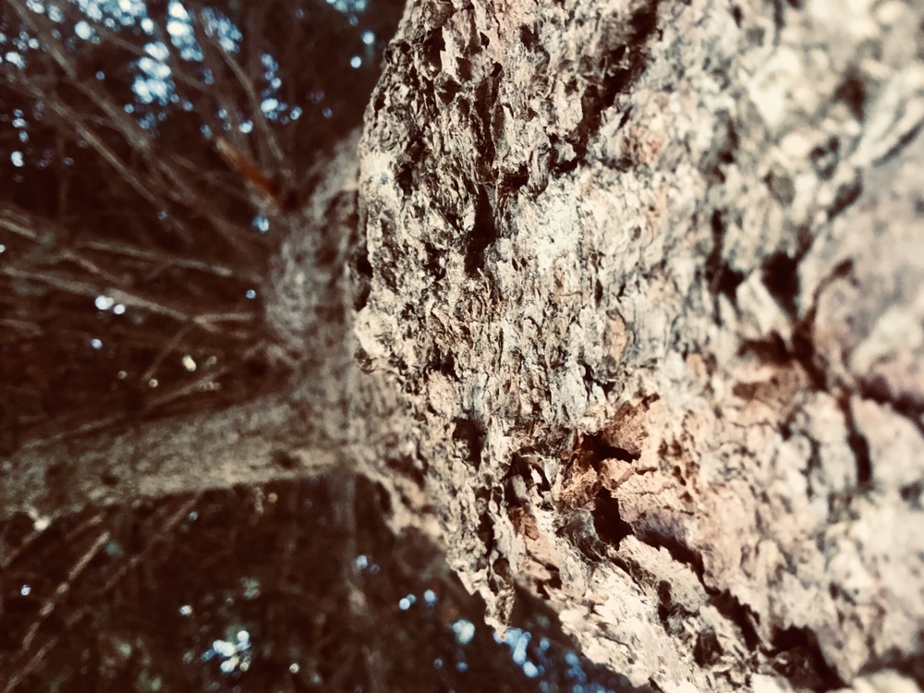
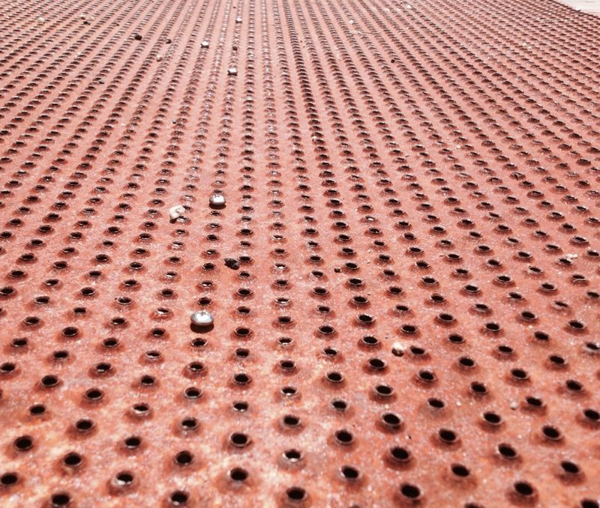
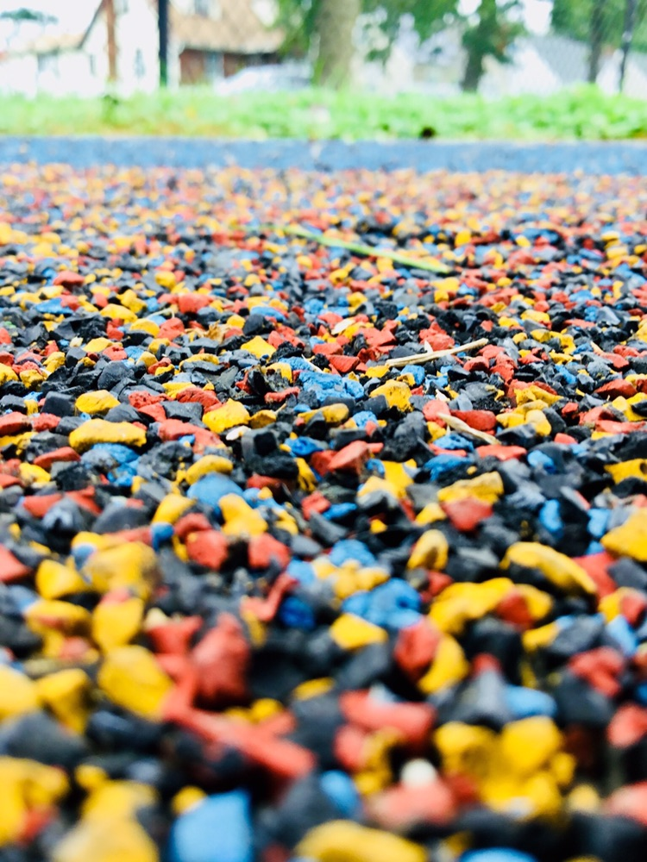
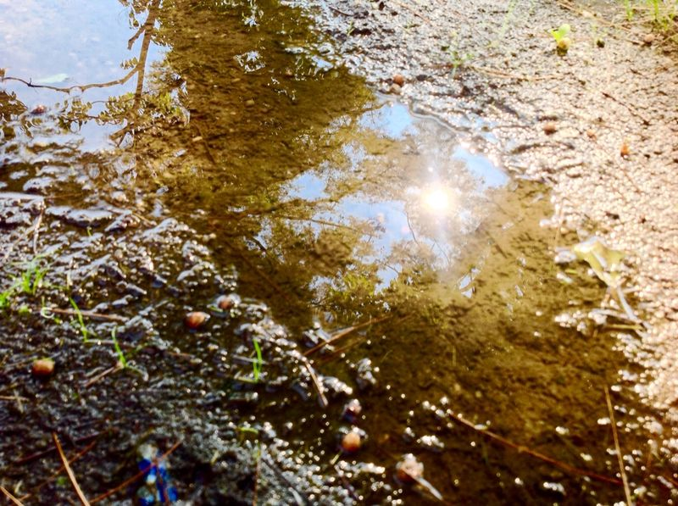
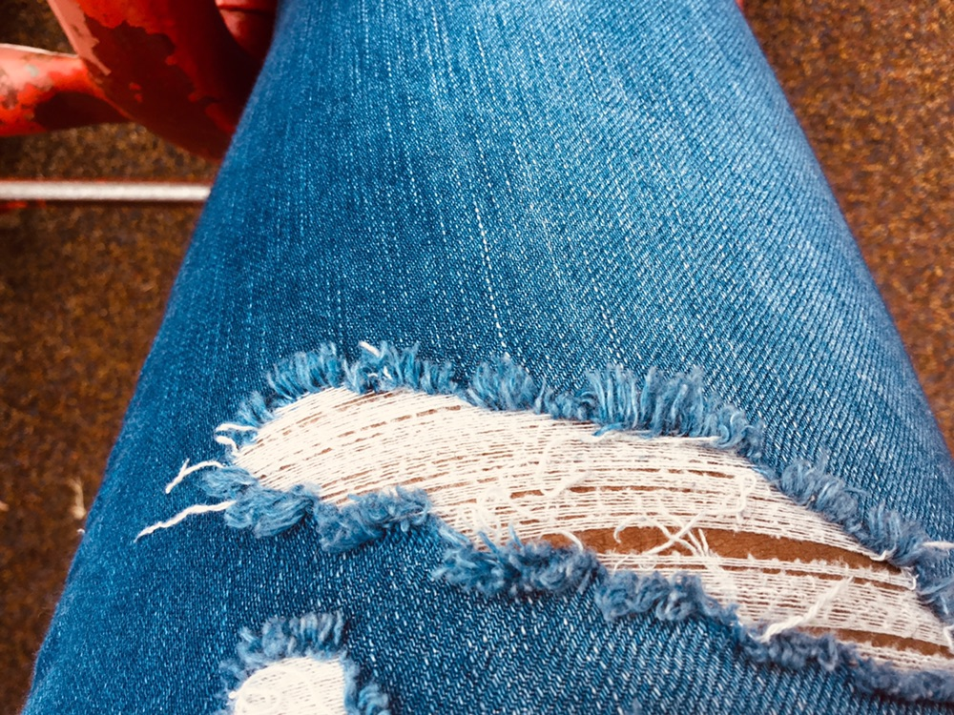
Examples of Texture Photography

Slide 10
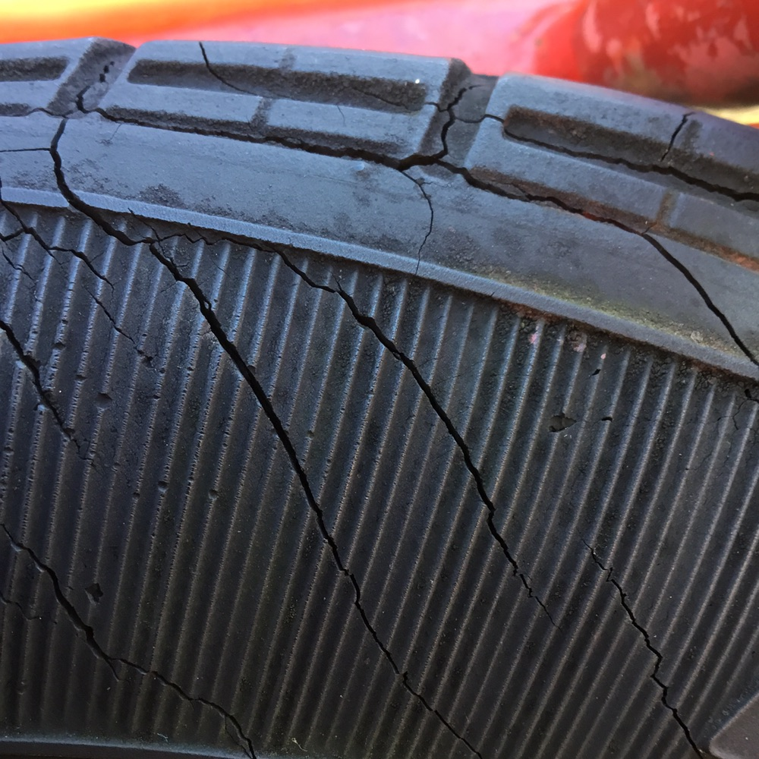
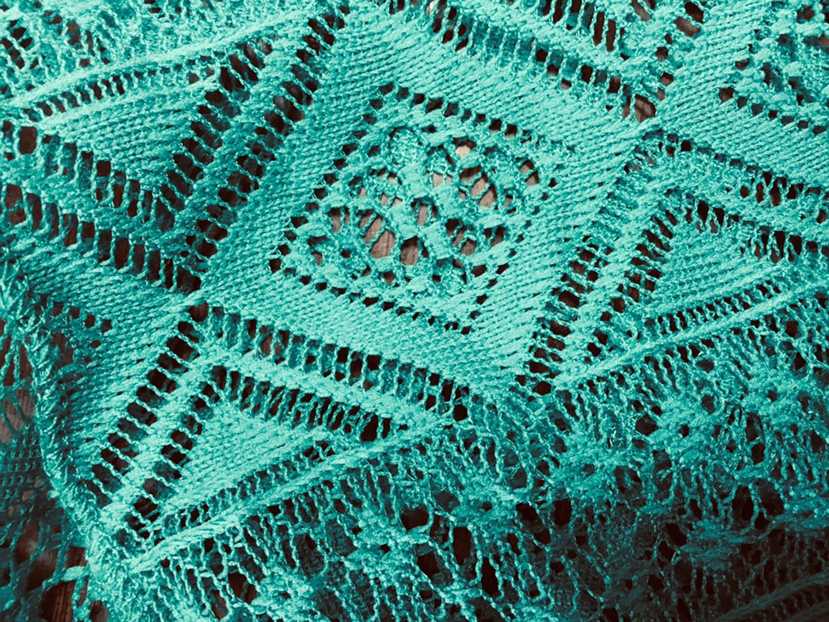
At Home Texture Photography Challenge: Finding Actual Textures and capturing images of Implied Feel
Find 5 different textures to photograph and upload the images to the Texture Photography Challenge Assignment Due Monday April 27th

