Slide 1
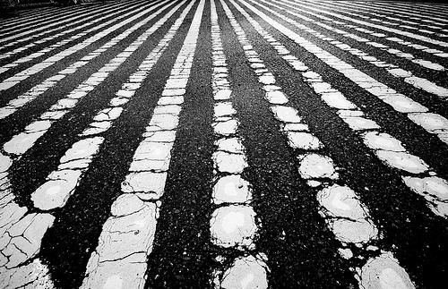
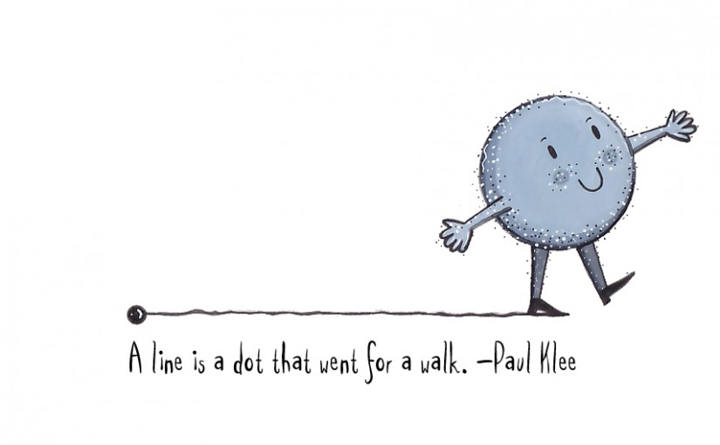
Art 6
Elements of Art Review
Line
At home review & Art Activities

Slide 2
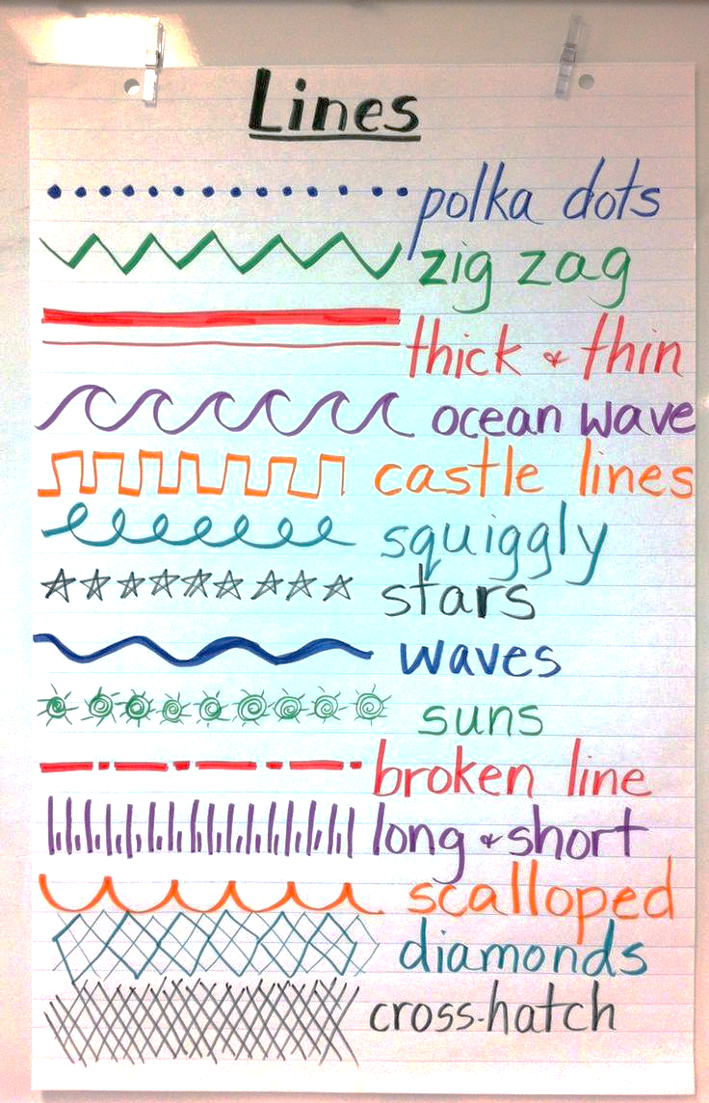
The boldness or thickness of a Line is called its
Line Quality.

Slide 3
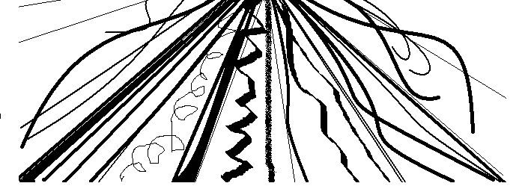
LINE
A line is a 1-Dimensional mark which often has greater length than width. It is used to define shape, contours and outlines. Lines can create value and texture.

Slide 4
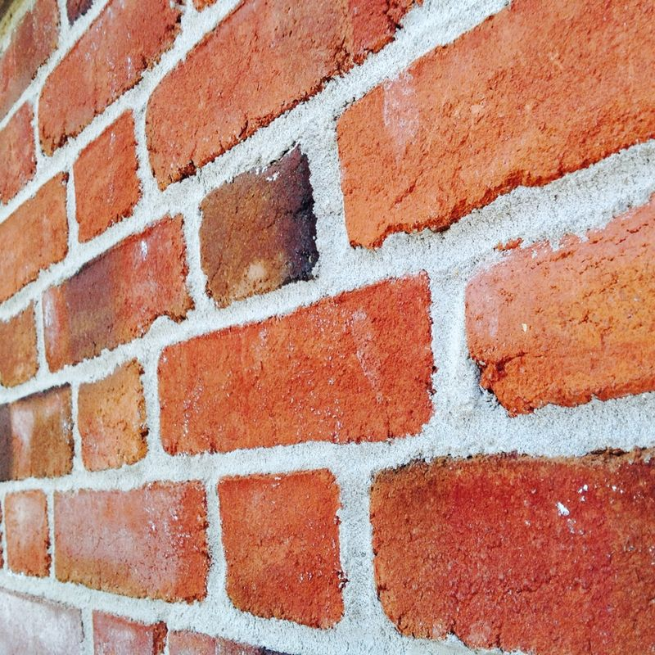
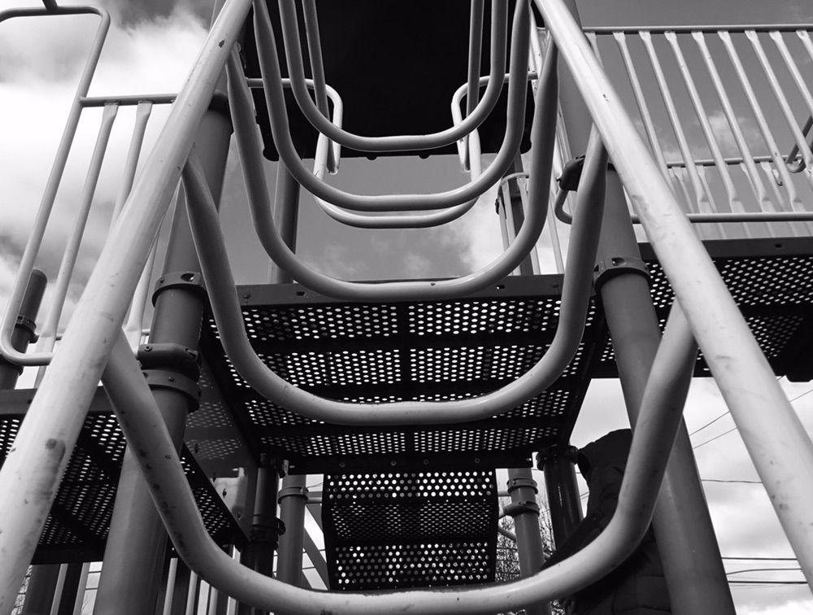
What is a line in photography?
A line in a photo is a point that moves away from the viewer, leading the viewer’s eye towards something...

Slide 5
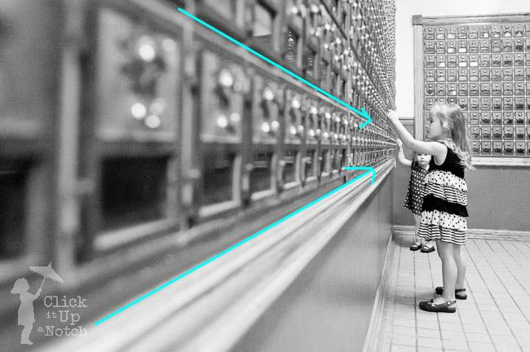
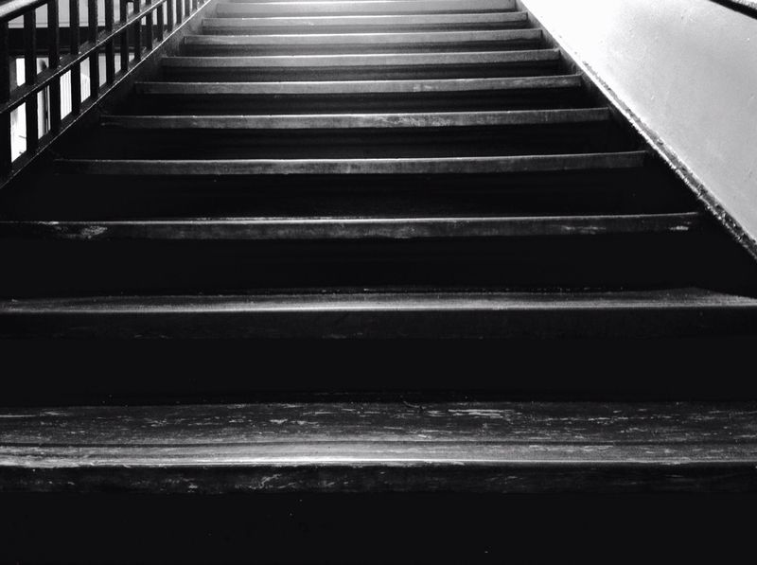
Some lines are actual, and some are implied.
actual
implied

Slide 6
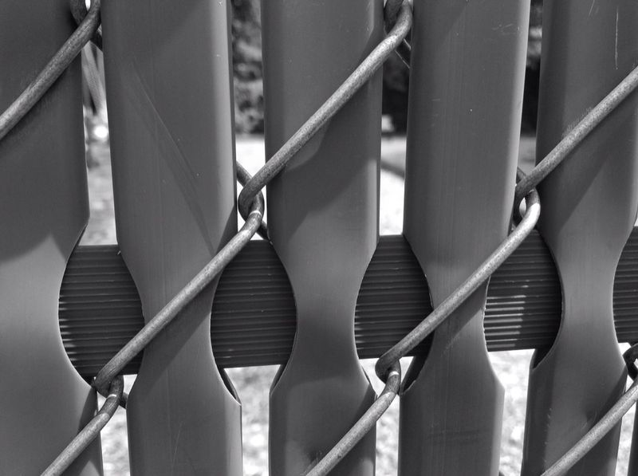
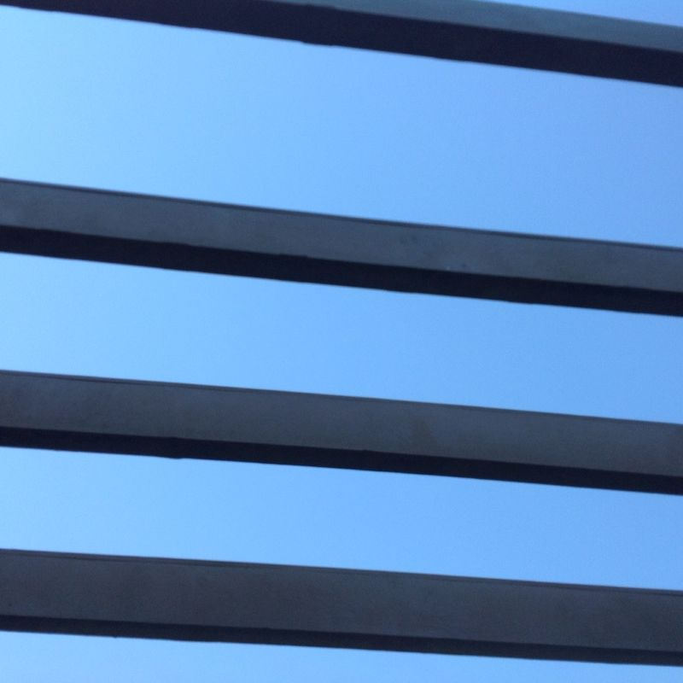
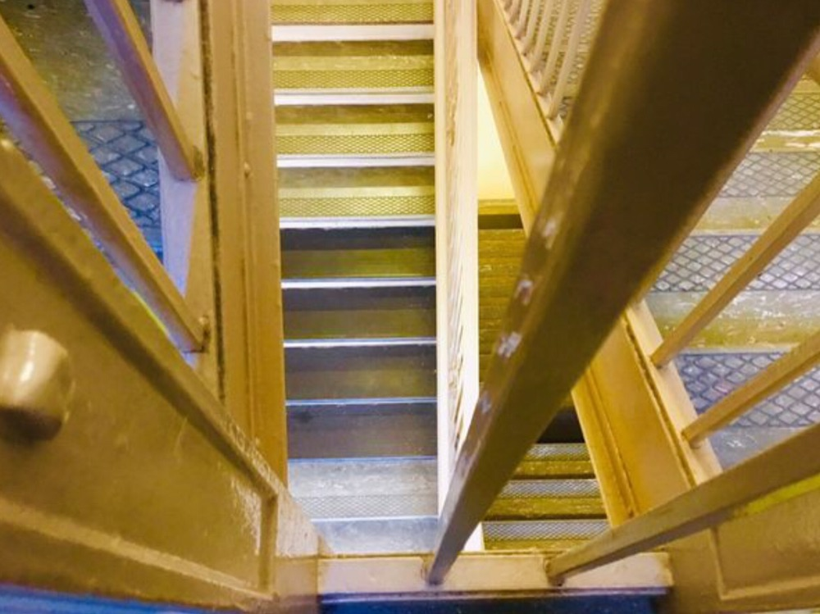
The viewer's eyes are naturally drawn along lines. This can be vertical lines, parallel lines, curved lines, diagonal lines, and even strong horizontal lines.

Slide 7
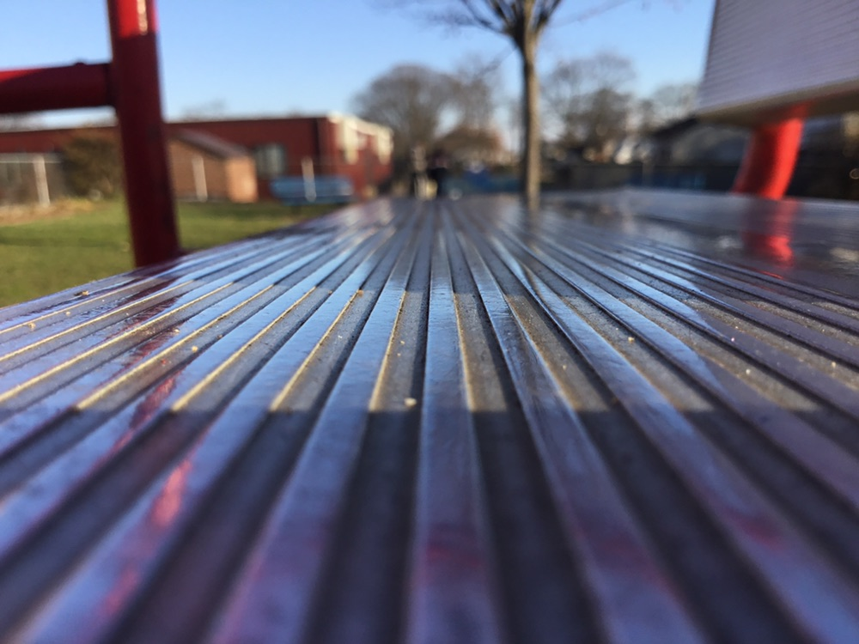
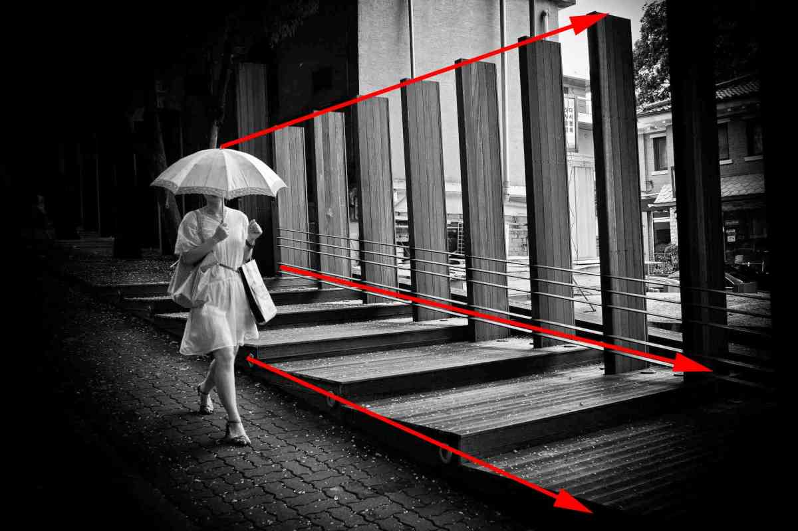
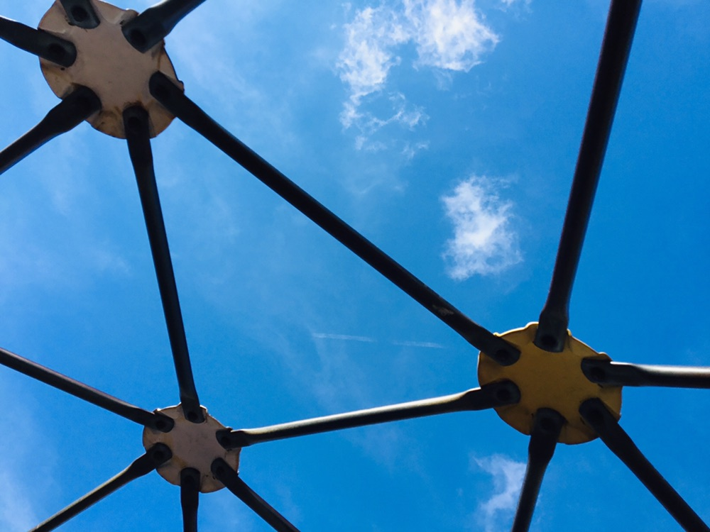
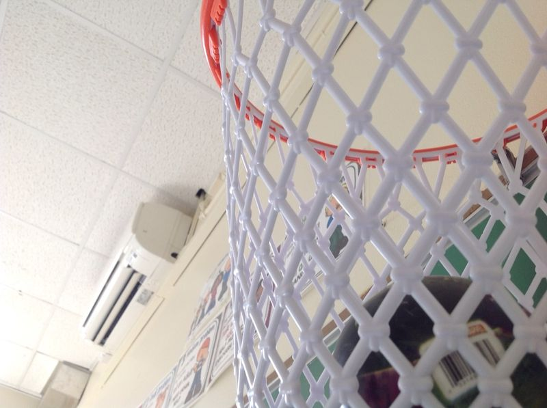
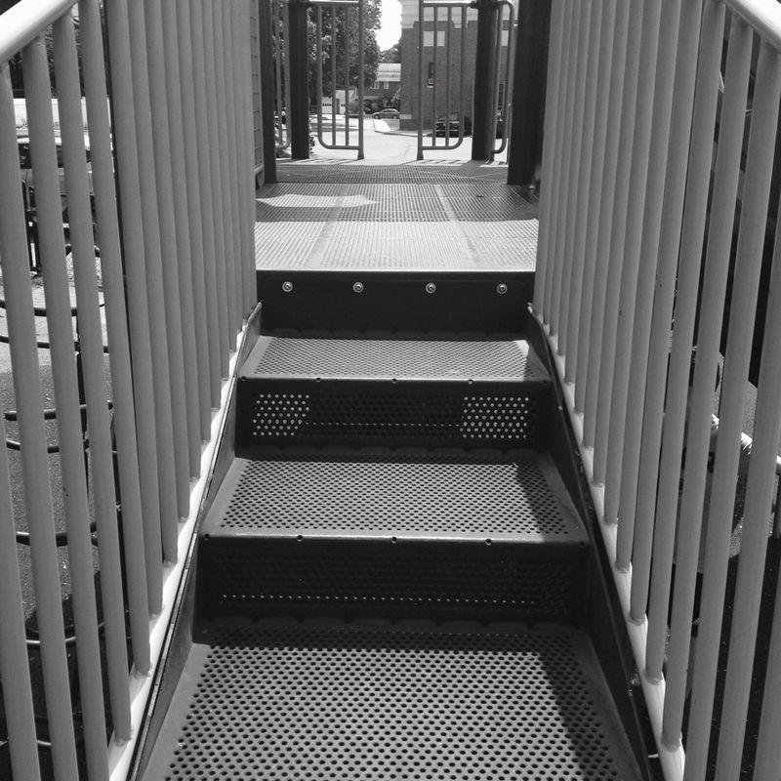
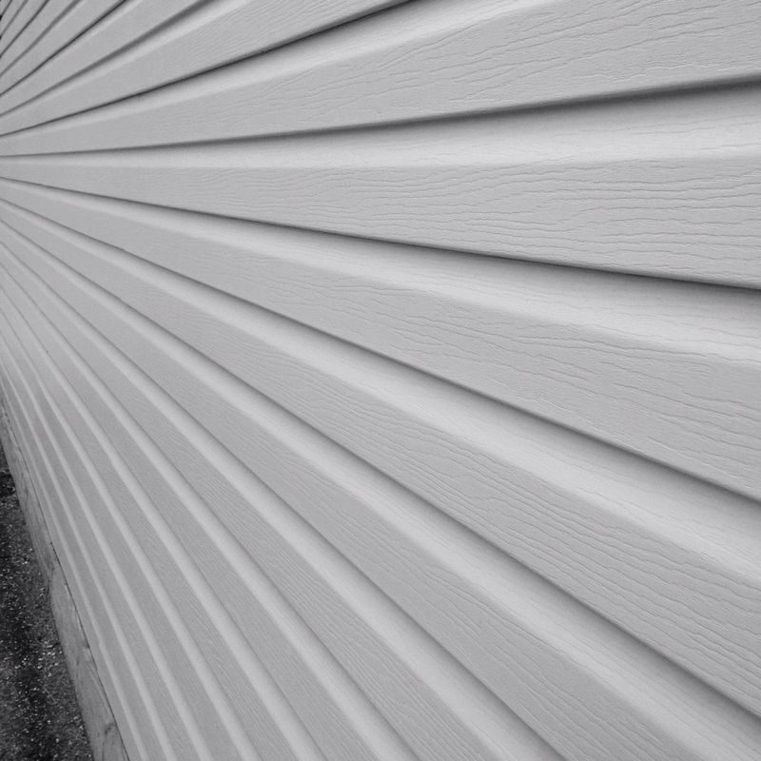
More actual and implied lines...
Bug’s Eye View: ipad ON the surface!

Slide 8
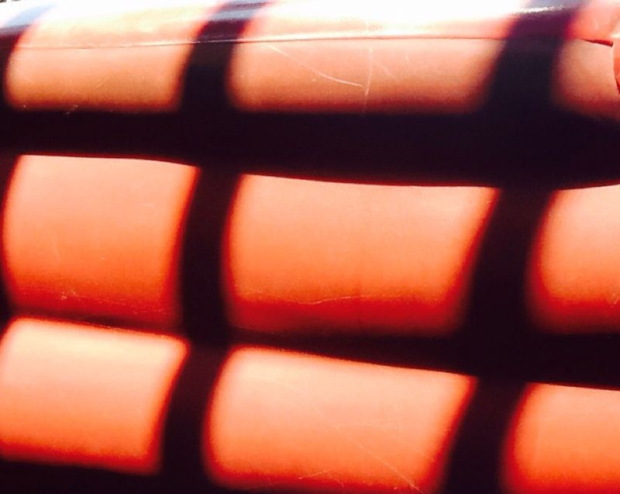
At Home Line Photography Challenge:
Finding Actual Lines and Implied Lines
Find as many lines to photograph as you can and upload the images to czellesartgarden@gmail.com (Due: Wed.May 6).

Slide 9
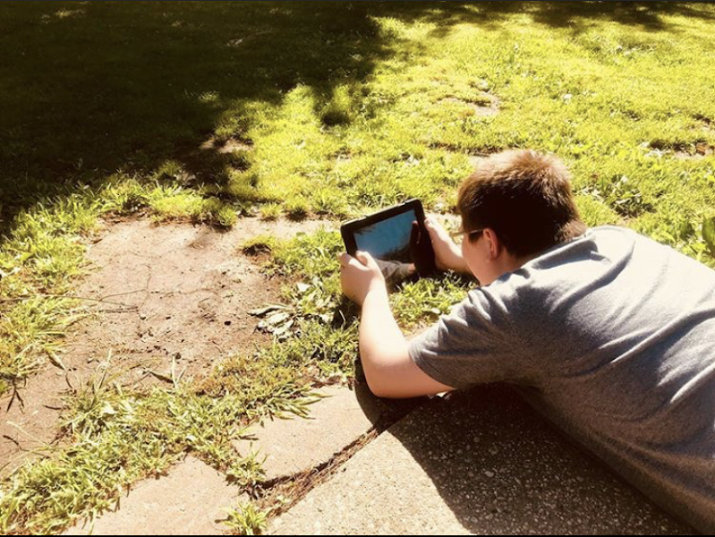
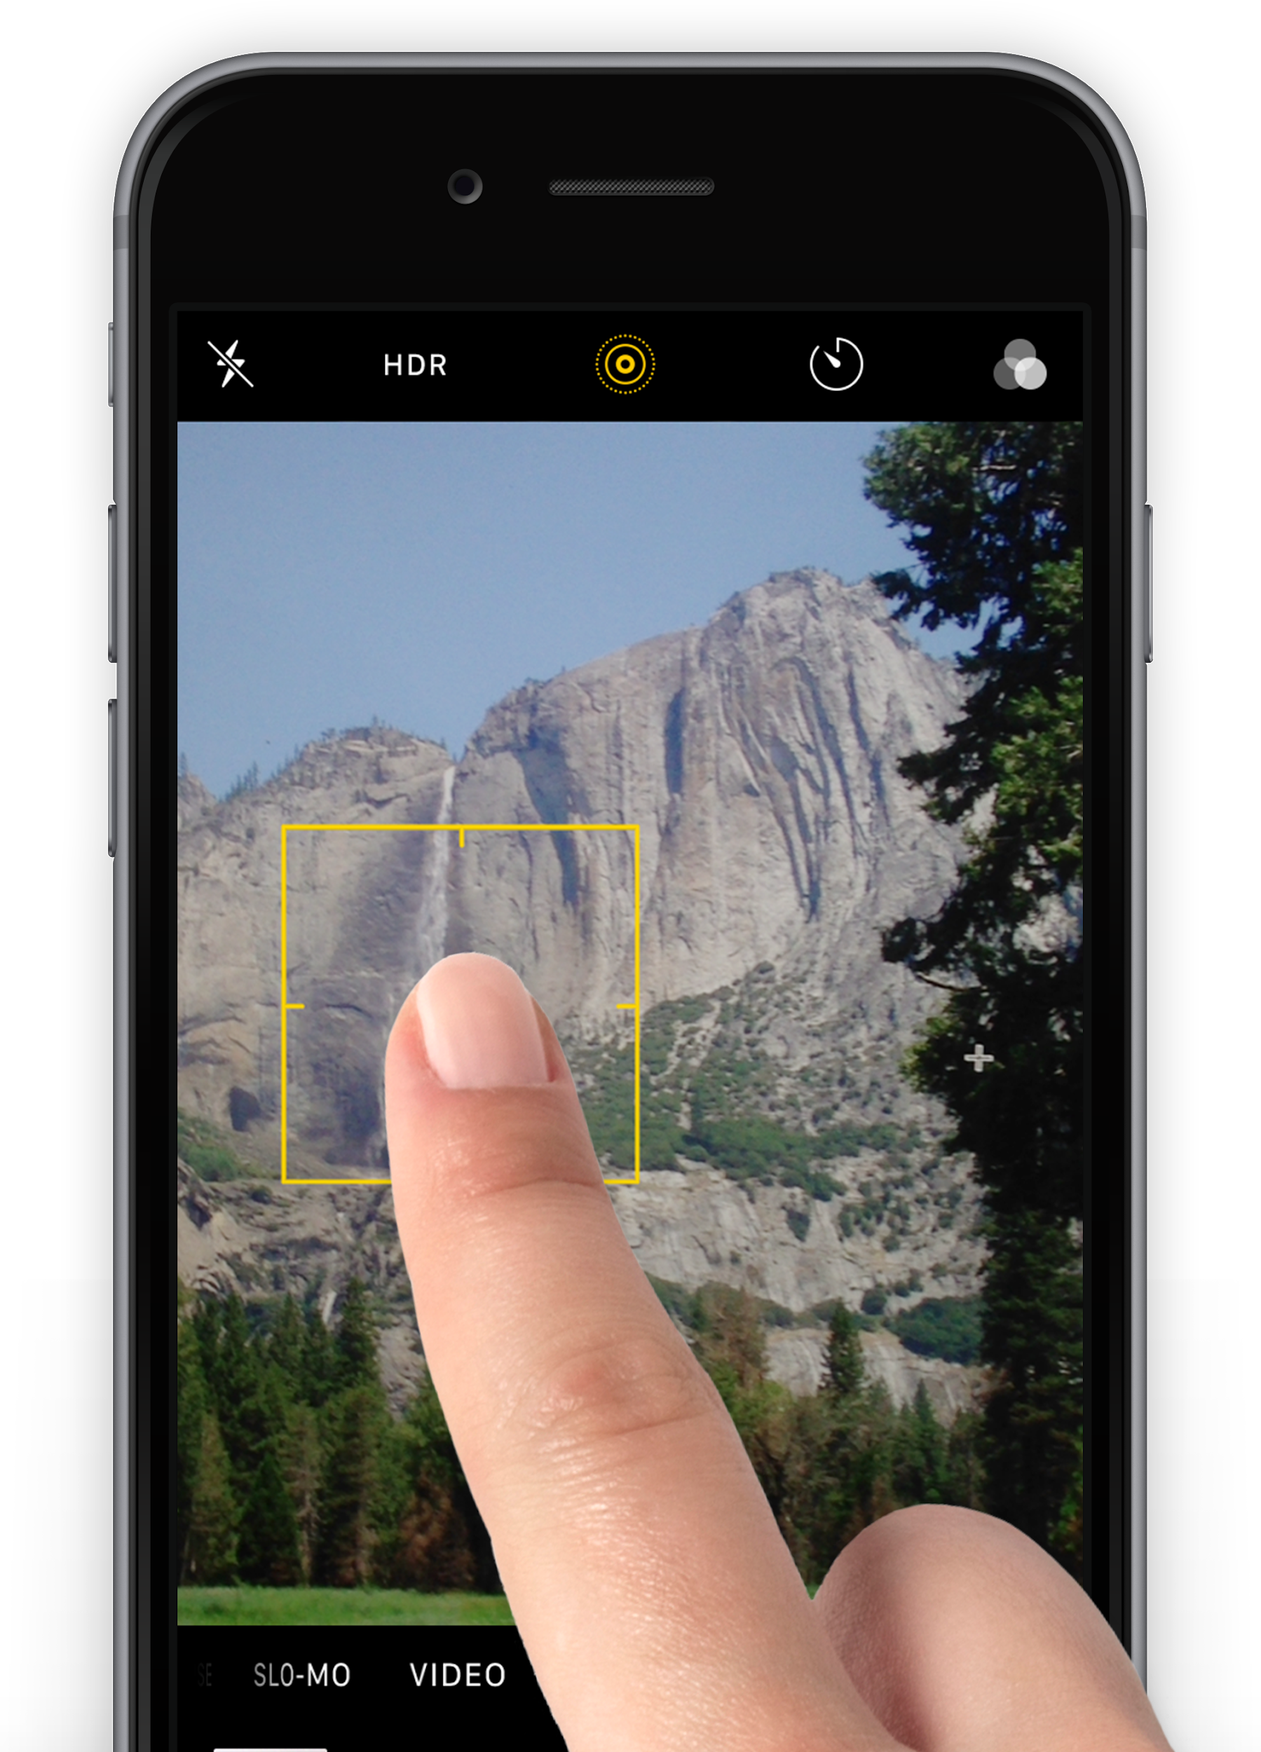
Don’t forget your previous skills from photographing texture!....
Tap to Focus
Get close, but not too close
Bug’s Eye view
Good Lighting

