Slide 1
L.P.R.R.D
By: SIXTH GRADE STUDENTS

Slide 3
Animal Symbol
We picked the animal, Leopard, because it represents us. Our group name is L.P.R.R.D which is a short form of Leopard and it has all of our group members initials. A leopard represents the people in our community because we are strong, independent, brave, smart, intelligent and protective.

Slide 4
Declaration of Independence ~ L.P.R.R.D
~~~~~~~~~~~~~~~~~~~~~~~~~~~
In America, they have a lot of problems with their society. First of all, they have a lot of violence and crimes. The government says that they would protect its citizens, meanwhile millions of families are suffering because of threats, blackmail, and family members getting killed. There is a lot of road rage on streets over unnecessary problems, causing people to be late to their destination and spreading hatred amongst people. In schools, there is a lot of bullying. This lessens kids’ motivation to want to learn, causing them depression, anxiety, and more mental/emotional issues. There are also a lot of rude people out on the streets. Citizens are rude to homeless people and other citizens around them.
In our community, we strive to protect our citizens so they could live their best lives. We will protect our citizens by preventing violence and crimes but with a punishment that helps the community. They would do community service with instructors watching over them and making them fix what they did wrong. If they didn’t do the community service, they would be exiled, and if they did the same crime again, they would have to do more community service. We would have internet, but only for the right reasons. We wouldn’t have the “dark web,” and blackmailing wouldn’t be an issue with the amount of protection an account has. If anyone tries to threaten others and if we see on our monitors that supervise people’s computers or if someone calls us and reports a threatening, they would be exiled. If anyone breaks the laws three times (except blackmailing and threatening), they would get exiled. There wouldn’t be road rage because people would be optimistic in our society, thinking on the bright side. Lastly, there wouldn’t be any bullying in schools. Unlike America, where they send you to detention and you get suspended, in our school, we teach children to do the right thing by being sympathetic and trying to get students to be optimistic. In our society, we try to protect people, not harm them in any way.

Slide 5
Laws
Law 1: Be accountable
Rationale: Honesty is the best policy. Less people are harmed if people are honest. Honesty not only benefits others around you, it makes you stronger. If we are honest no grudges or hate towards others who “ratted you out” will be present.
Law 2: No harmful acts
Rationale: Harmful acts damage. They damage the economy, the mental and physical state of the people who reside in the environment.
Law 3: Be respectful
Rationale: If we are respectful of everything given activities will be much more pleasant. People have flaws, struggles, beliefs/morals, and opinions
Law 4: Abide by the laws
Rationale: Laws make people safe. If we abide by the laws people will feel safe and welcome.
Law 5: Rights can not be abused
Rationale: Freedom of speech is often abused. Since people have opinions that make others with a certain skin color, gender, or religion get shunned and scolded from society we took away abusive rights.
Law 6: No weapons
Rationale: Weapons lead to violence. Violence leads to death and destruction. Death and destruction lead to harm. Since we eliminated weapons there will be no; school shootings, church/synagogue/temple shootings, and homicide.
Law 7: Worship Dante, Rania, Raiyan, Paul, Luigi
Rationale: We made the perfect place. You live in it. We are your superiors. Be grateful for what we have done for you or we will take it away.
Law 8: Act right
Rationale: We took you in. We do everything for you. Represent us. If you don't look good we don't look good.

Slide 6
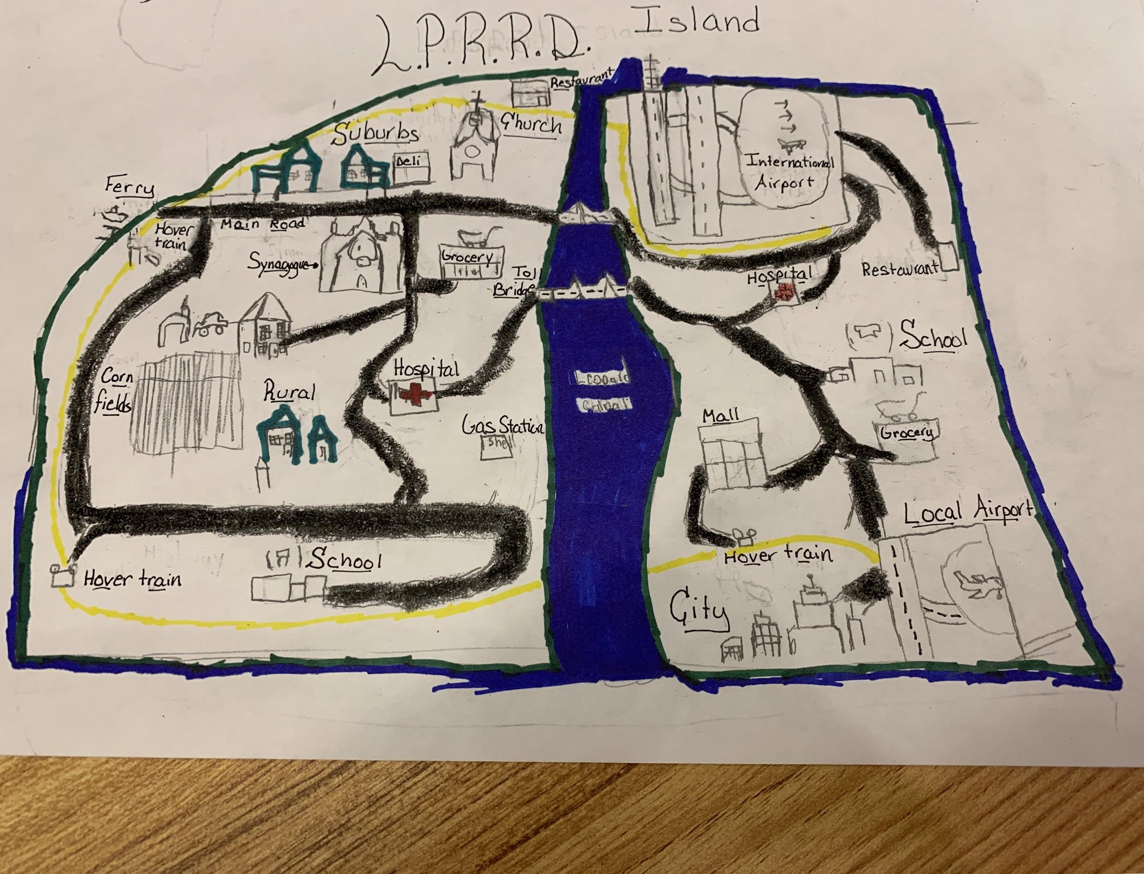
Map:
We have hospitals in our community incase someone gets injured. We have schools in our community that provide the best education they can. We have lots of transportation routes like the HoverTrain, where it can can take you all over the island. We have two airports: a local and an international. We have a city where people work and can make 15-50 dollars an hour. We also have a synagogue where citizens could worship the creators. We also have a sport stadium for fun.

Slide 7
Schedule
The schedule was too big so here is a link:
L.P.R.R.D Schedule link

Slide 8
Journal Entry
Friday
This morning mother woke me up at 8:30 to get ready. Once I completed my morning routine I ate the morning meal. At 9:00 I began my typical school day. Then I went back home at 5:00. Once there I completed my after-school assignments. Then it was free time from 6:00 to 8:00. Then it is the night meal. After that, it finally feels like Friday. Once we are finished with the night routine, it is bedtime at 9:00.

Slide 9
Journal Entry
Saturday
I woke up at 8:00 am and did my morning routine until 9:00 am. Then I went to religion school from 10:00 am to 2:00 pm. Tehn I had free time from 2:15 pm to 7:00 pm because it is a weekend day. Than I had dinner from 7:00 pm to 8:00 pm. After hat I went to bed at 9:00 pm.

Slide 10
Journal Entry
Sunday
It was like any other sunday. I woke up, ate, got changed and went to religion school. Than was my outrageous amount of free time after. Then it was dinner and bed.

Slide 11
Advertisement
Are you sad about your current community? Come in our perfect community, L.P.R.R.D! There is no violence and a great education system. We have any of your likings. Sports? We got that! The best restaurants? We got that, too! You probably don’t even make money in your community, but the more you work the more you make in our perfect community. Do you even make life decisions, like where you want to work? In here you get to choose whatever jobs you want, a pilot, doctor, teacher, cashier, and more. Join us and become and official L.P.R.R.D citizen!
Violence Free Is The Way To Be!!

Slide 12
Grading & Rationale
Please do not delete comments made or the grade left. Please leave this document in its final form
*after reviewing the slides and presentation:
-The issues you presented did not seem to address some of the worlds greatest issues. You highlighted violence and bullying, which are good issues to address, but road rage and rudeness to poor (instead of poverty in general) were lesser issues. The laws you created are moral rather than legal and too vague to apply to life in a community. Most importantly, the journal entries you provided were not indicative of life in your community. They were underdeveloped and did not give insight to how citizens of the community benefit from living there.
Overall Score: 80

