Slide 1
By: SIXTH GRADE STUDENTS

Slide 2
Declaration of Independence
We will form a nation, Outreach, to fix the problems we see with this world. Outreach will solve our current problems with health, medicine, and innovation through new inventions and ways of thinking. The old world had violence. We will fix this problem by enforcing fines and laws that are very strict in order to stop it. There was also homelessness. That won’t be a problem because basic necessities like food, water, shelter are provided by the government.
There will be jobs for people to distribute the food equally to everyone. We will also ensure there is a surplus of food by growing lots of it. That way, no one will go hungry. Every citizen is given a home and clothes, and they can buy better things if they need to.People have jobs and can buy their wants. We have solved these problems to blaze a new trail for the future. Outreach will strive to become a haven of peace and a place of learning. We will obtain knowledge and solutions to reinvent the future!

Slide 3
Outreach Rules
Outreach has created rules to ensure that the community thrives. These rules are listed in relative importance. They are as follows:
Community members without jobs have to do mandatory community service. This is so that people without jobs aren’t just living off of the government.
Violence is prohibited towards humans with the exception of enforcing such a law, or self defense. This law ensures that innocents won’t get hurt in any way. Harming others in any way will result in fines and jail time.
Animal cruelty is prohibited, as well as poaching. Animals, as well as people, shouldn’t be harmed for no reason. At Outreach, we value all life.
Theft is prohibited. This law makes sure that people have ownership and credit of all that belongs to them.
All medications within the community must be prescribed by a qualified doctor. This will prevent further harm to the patient by ensuring people to a doctor's care.
No firearms but there is a mandatory self-defense and survival classes, so people will be able to defend themselves but won't harm others for no good reason
Public school k-12 will have the same education/curriculum as we have now in the US, for everyone. Also, there will be grad schools, med schools, college, etc. This will ensure people will receive necessary education to take part in the community.
Everyone has pay based off their jobs, because this is a matter of circumstance that can vary depending on your job.

Slide 4
How are necessities provided?
Our necessities are given to each citizen when they do they’re job. If you are unemployed you have to do community services. Therefore no one will be living off the government’s money. But if you would like you can get extra spending money but you have to do work that is outside your job. Now people have all their basic necessities, and can earn extra spending money. Therefore no one will be starving and there will be no poverty, this is a reliable system because now there are no more homeless people living on the streets and no shelters. We have open trade routes but we have to know who is shipping to us and who is expecting mail.

Slide 5
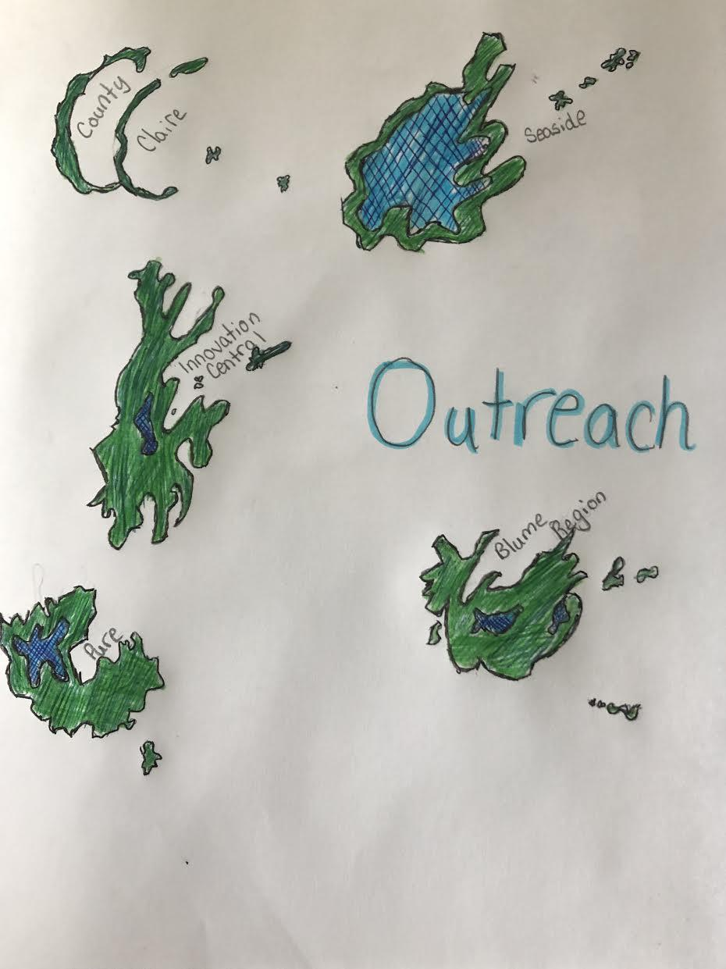

Slide 6
Schedule of an average citizen
Time | Monday | Tuesday | Wednesday | Thursday | Friday | Saturday | Sunday
6:00-8:00 am | Wake up, get ready, go to school or work. | Wake up, get ready, go to school or work | Wake up, get ready, go to school or work | Wake up, get ready, go to school or work | Wake up, get ready, go to school or work | Wake up/free time | Wake up/free time
8:00-12:00 pm | Morning work or classes for adults and kids, lunch break starts at 12:00 | Morning work or classes for adults and kids, lunch break starts at 12:00 | Morning work or classes for adults and kids, lunch break starts at 12:00 | Morning work or classes for adults and kids, lunch break starts at 12:00 | Morning work or classes for adults and kids, lunch break starts at 12:00 | Free time (Homework if any) | Mandatory survival classes
12:00-3:00 pm | Lunch break ends at 1:00, afternoon classes for kids, afternoon work for adults | Lunch break ends at 1:00, afternoon classes for kids, afternoon work for adults | Lunch break ends at 1:00, afternoon classes for kids, afternoon work for adults | Lunch break ends at 1:00, afternoon classes for kids, afternoon work for adults | Lunch break ends at 1:00, afternoon classes for kids, afternoon work for adults | Mandatory survival classes | Free time (Homework if any)
4:00-6:00 pm | School ends at 4:00 do any homework or projects when done get ready for dinner at six and clean up | School ends at 4:00 do any homework or projects when done get ready for dinner at six and clean up | School ends at 4:00 do any homework or projects when done get ready for dinner at six and clean up | School ends at 4:00 do any homework or projects when done get ready for dinner at six and clean up | School ends at 4:00 do any homework or projects when done get ready for dinner at six and clean up | Free time (homework if not done) | Free time (homework if not done)
6:00-9:00 pm | Two hours of free time, get ready for bed | Two hours of free time, get ready for bed | Two hours of free time, get ready for bed | Two hours of free time, get ready for bed | Two hours of free time, get ready for bed | Get ready for bed ,free time | Get ready for bed ,free time
9:00-10:00 pm | Go to bed | Go to bed | Go to bed | Go to bed | Go to bed | Go to bed | Go to bed

Slide 7
Journal of Angelica Walsh, an Outreach citizen
Dear Journal,
My life is kinda simple. Going to school, homework, classes, it’s that simple in Outreach! I visit the Innovation Center often, I helped the people there. I also visit the public library for books I need for school or just to fun read. I mostly read about nonfiction stories of Outreach. We have Innovation technology, like the Innovation computers. Most of the technology in Outreach comes from Innovation central. Outreach has a forest, it is perfect for playing in. The wildlife creates such an inviting ecosystem. Gatherers also come to collect the berries and herbs that grow in the forest. Outreach uses the herbs and berries for trading or medicine. Outreach gets most of their items by trading overseas. Me and my friend Isabella usually sit by the dock where the ships would come and give Outreach the resources we need. The ship usually gave us food, like fish, pork and other meats, useful herbs and berries, like mint and other herbaceous plants, we also get strawberries and other berries, my favorite. Sometimes, the ships gives Outreach wooden planks, seed for new plants or herbs, tools for gatherers or harvesters, and entertainment like toys, dolls, action figures, and board games. The ships also brings Outreach new book to put in the public library. I love the ships! Tomorrow, the ships will come. And it is my birthday in 2 days, so maybe it will bring me something special!
Your Friend,
Angelica Walsh

Slide 8
Journal of Angelica Walsh, an Outreach citizen
Dear Journal,
Hello! I am back again. And tomorrow is my birthday!!! I am so excited! Give me a second, there is a knock on the door. Ok I just answered the door and this man gave me a giant package, for me! I can’t wait to open it, but not until my parents come home from work. I can’t wait to see what’s inside this package! I’m really excited to open it. Oh wait... I see a note on the package. It says: “ Happy birthday Angelica!!! I hope you like this present!!! P.S: Don’t open it before your birthday. P.P.S: I’m coming to your birthday party. From, Isabella Hallsworth.” Yayy!! My BFF is coming to my birthday party! Speaking of my birthday, I should make invitation cards to invite my friends to my birthday party tomorrow! I love life at Outreach. It’s an easier way of living because everything that I need and everyone else needs to live are provided. It’s great! And the ship brings us our necessities, but it sometimes brings us special treats. Speaking of special treats, I wonder what my present from Isabel will be? And if the ship brings me a present, what will it be? I’ll have to tell you later. Hold on, my parents are home!! See you tomorrow!! And I’ll make sure to tell you what I got!
Your friend,
Angelica Walsh

Slide 9
Outreach
Inventing the future
Are you tired of living in a place with violence and homeless? A world in which people still don’t get what they need, and there are still problems to solve? Then come to Outreach. We’ve developed solutions to all of these problems. Basic necessities are provided so that you don’t have to worry what to eat or where to sleep at night. We are dedicating more time and money to find new solutions to problems. We will develop new medicines. We will stop homelessness and hunger and improve health. Outreach is the better way of living! So come to Outreach, a nation focused on looking to the future, not the past, and we
INVENT THE FUTURE!
Notes:
The other one looked beautiful

Slide 10
Credits
Political leader: STUDENT A
Urban Planner: STUDENT B
Marketing Director: STUDENT C
Recreation Director: STUDENT D
And a special thanks to Mr. D’Anna for letting us do this project! :)

Slide 12
Grading & Rationale
Please do not delete comments made or the grade left. Please leave this document in its final form
*after reviewing the slides and presentation:
-You begin with a great community sigil and orderly discussion of society’s ills. Your plans are well-intended, and your laws are fair. Some, though, create “shades of grey” wherein it becomes difficult to enforce the laws. Your map is sufficient but, again, could create problems as your community is split up amongst five islands. Your schedule was very detail-oriented and provided clear guidelines for citizens. The journals, though, did not read as reflections of your daily life. Instead, they seemed to be explanations of your daily schedule. Most importantly, you only included 2 of the 3 required journals.
Overall grade: 89

