Slide 1
Elements of Art Review
COLOR
At home review & activities

Slide 3
Color Families
Primary Colors:
Primary colors are the 3 pigment colors that can not be mixed or formed by any combination of other colors. All other colors are derived from these 3 hues.
Red, yellow and blue
Secondary Colors: These are the colors formed by mixing two primary colors. Green, orange and purple
Tertiary Colors: These are the colors formed by mixing a primary and secondary color.
Yellow-orange, red-orange, red-purple, blue-purple, blue-green & yellow-green

Slide 4
Complementary Colors
RED & GREEN
YELLOW & Purple
BLUE & ORANGE
Across from each other on the color wheel

Slide 5
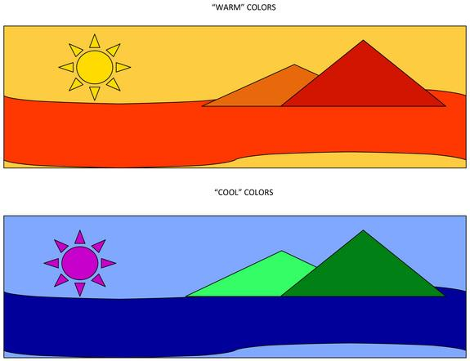
Red
Orange
Yellow
Green
Blue
Violet

Slide 6
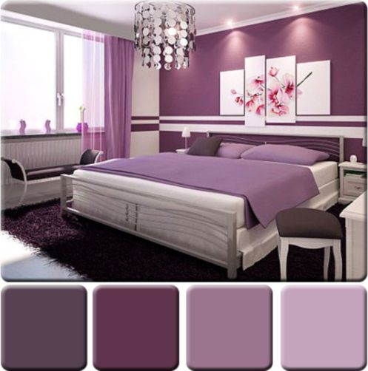
Monochromatic Color Scheme
TINT (+white)
TONE (+grey)
SHADE (+black)
of 1 Color/Hue
Mono- prefix meaning one

Slide 7
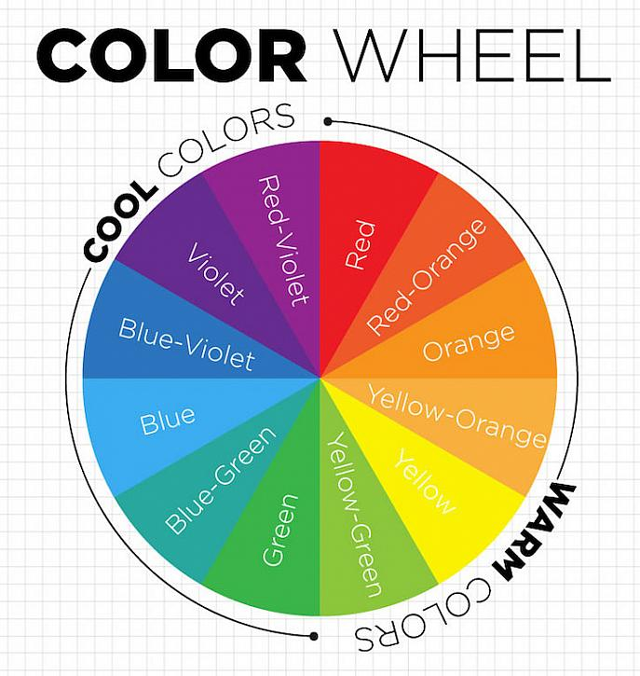

Slide 8
At home Color Challenge:
Create a Monochromatic
(1 color) Found Object Design, photograph & upload!
Pick 1 color and arrange different items of that color to create a monochromatic picture! Do this for 2 different colors

Slide 9
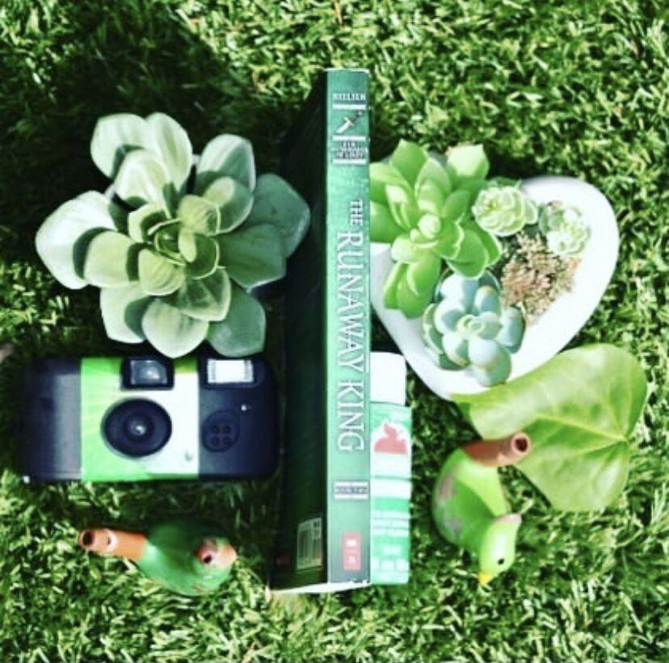
Tips for taking a good photograph:
Choose a simple background
Pick a spot with good lighting, close to a window is best!
Take a bird’s eye view of the arraignment, meaning from above facing down
Option, if you know how, photograph it as a square, or crop it later.
HAVE FUN! Add or remove objects and rearrange as much as you want!

Slide 10
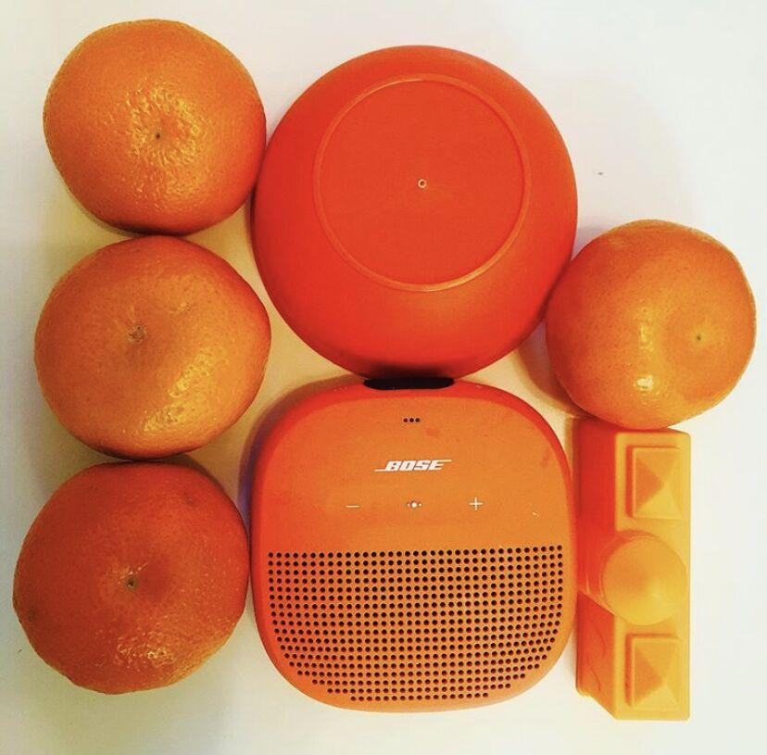
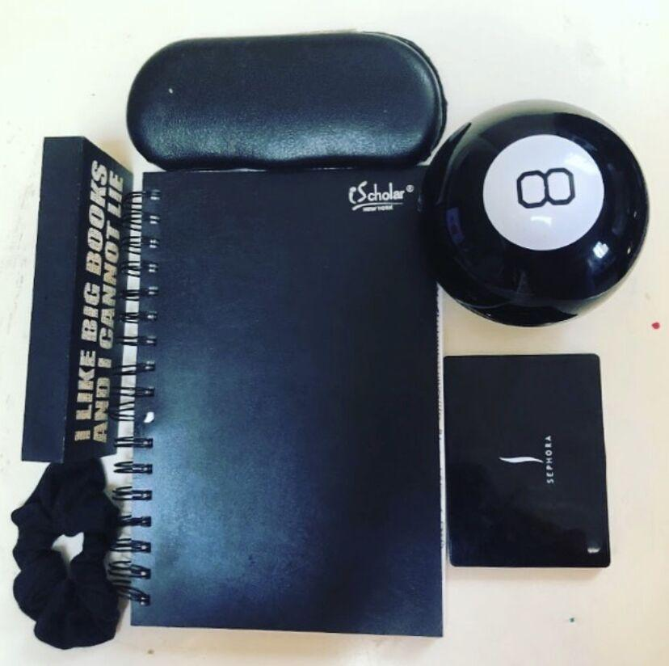

Slide 11
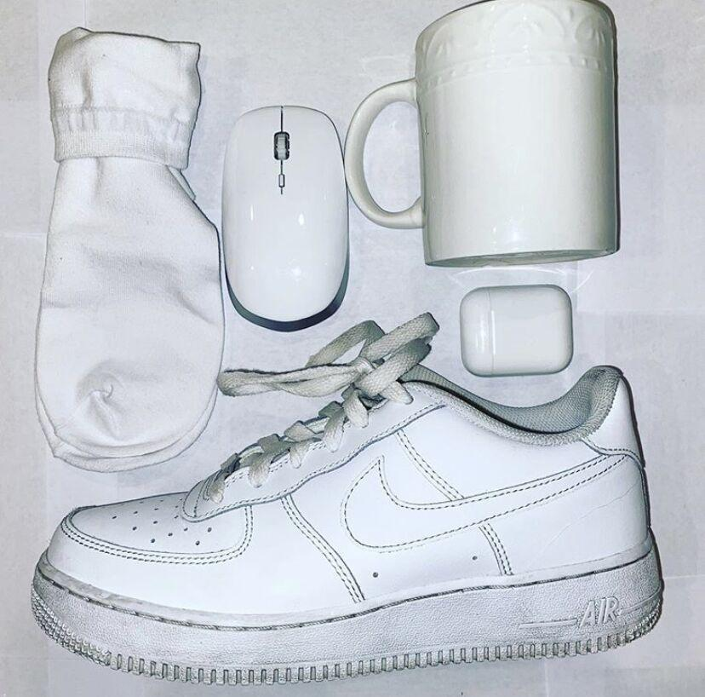
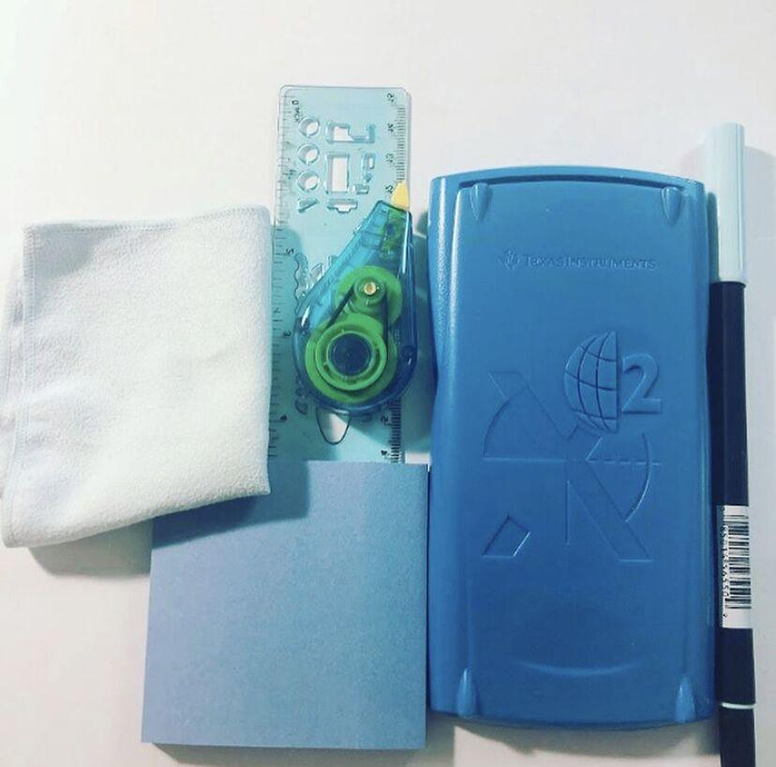
Please upload at least 2 photographs and email them to czellesartgarden@gmail.com

