Slide 1
Isla Zalem
By SIXTH GRADE STUDENTS

Slide 2
Seal and Motto
No matter how many times you try to stop us, we will
always get back up!

Slide 3
Declaration
In our current world, there are many laws. Some people still break these laws, and the government doesn’t do much about it. In our utopia we will enforce these laws more. We won’t just sit there and let it happen - we will do something about it. Every crime that is committed will be punished. For example, murder will result in jail for the rest of your life. However, we will make sure that only guilty people will go to jail. We will pour ourselves over each and every case. We will not favor one case over the other. An innocent person will never go to prison. We will end hunger and homelessness in our utopia by providing homes and money for resources to our citizens. Our way of making this happen is by taking a portion of money from our offshore businesses, such as banks and large corporations, as well as from local taxes and giving it to people who need it. There are many homes for people to take, so no one will be homeless.

Slide 4
Laws
No killing. (Police and military have certain exceptions).
Murder is wrong.
No vandalism.
We do not want people to deface our island.
No smoking/vaping/drinking.
We do not want anyone to die of addiction.
No weapons or artillery. (Exceptions include police and military).
People might get really mad and do something they didn’t want to do.
Any type of abuse is illegal.
We will not allow anyone to put someone through something wrong.
No partying after 11:00 P.M.
It might wake people up.
Every child gets the same education. (K-12)
Everyone deserves an opportunity to be great.

Slide 5
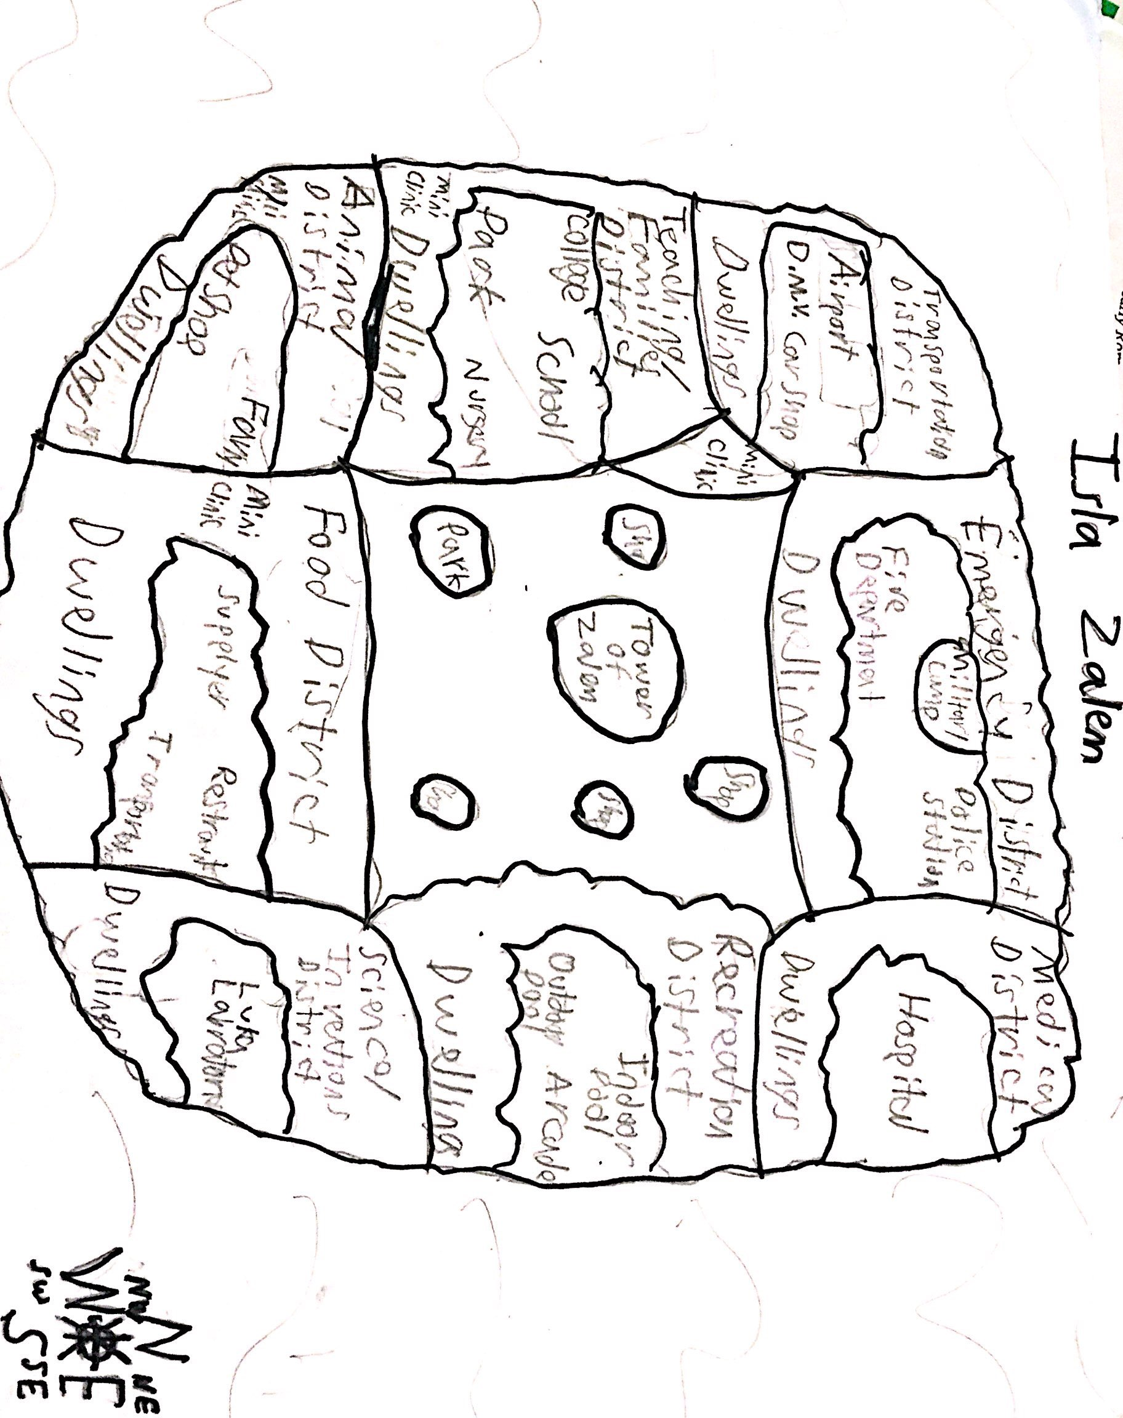
Map of Isla Zalem

Slide 6
Schedule
Day- Time | | Sunday | Monday | Tuesday | Wednesday | Thursday | Friday | Saturday
7:00 A.M. | Free | Wakeup | Wakeup | Wakeup | Wakeup | Free | Free
7:30 A.M | Free | Breakfast | Breakfast | Breakfast | Breakfast | Free | Free
8:00 A.M. | Free | School/Work | School/Work | School/Work | School/Work | Free | Free
10:30 A.M. | Free | Lunch | Lunch | Lunch | Lunch | Free | Free
1:50 P.M. | Free | School/Work | School/Work | School/Work | Free | Free | Free
3:00 P.M/ | Free | Optional Activities | Optional Activities | Optional Activities | Free | Free | Free
5:00/ 6:00 P.M. | Free | Dinner | Dinner | Dinner | Free | Free | Free

Slide 7
Journal Entry - Friday
Today is Friday, and we, the community, have off from school and work, so the substitutes went to cover for the adults. We had our breakfast delivered to us at 9:25 A.M., and we ate it at 10:00 A.M. Since we made our own schedule for the weekend, it’s recreation time. In recreation time we go to the arcade because it’s our favorite thing to do. However, we played board games like Scrabble and went for a swim first.
We had a delicious burger for lunch. It is a favorite in Zalem. We then studied for upcoming tests and did our homework. When the day was nearly over, we went to the pool for a quick swim. We then went back to our house. I can’t wait for another great day in Isla Zalem.

Slide 8
Journal Entry - Saturday
Today is a perfect Saturday, the sun is shining, and the grass is a vibrant green. First, we all participate in the Saturday religious services. Sometimes they are boring, but singing at the top of your lungs is fun.
Well,so much for perfect weather. It’s rainy, but that never stops the people of Zalem. We simply went to the indoor pool, because it was to hot and wet to be outside. We played some indoor water games and had chicken tenders for lunch. I had some homework and reading to catch up on. I hope to have another great day in Zalem.

Slide 9
Journal Entry - Sunday
Today is Sunday, and my parents have planned the whole day out. First, we ate our breakfast. Then, we went to the big park by the school. We spent a whole hour there and had a lot of fun. We then went to the outdoor pool and took a swim. We played marco polo and water tag.
For lunch, we had a big pizza. Anywhere else in the world, I would have hated it. But in Isla Zalem, the pizza’s are delicious. We went back to the pool for a little and had some fun. We then went back home. I can’t wait for another day in Isla Zalem.

Slide 10
Advertisement
Welcome to Zalem, a place where you will never regret living in. You may be wondering why it’s such a great place to live in. Well, our laws are very reasonable. It keeps everyone in place and organized. This helps our people in Zalem because they get to live a better life. We have shops, parks, and jobs that you could get into without a doubt. You will be provided a house that you won’t even have to pay for, plus any type of job that you would want to get into as soon as you come into our community. Everyone helps each other out and you will feel welcome. Hope to see you soon!

Slide 11
Grading & Rationale
Please do not delete comments made or the grade left. Please leave this document in its final form
*after reviewing the slides and presentation:
-The map, journal, and advertisement were lacking. You seemed to have a good idea of how you wanted your community to operate, yet it there were a few shortcomings in your explanations. I’d have like to see a more tight-knit community, or at least one where different districts worked together in harmony rather than independent of each other. As insightful as the journals were, they could have been an opportunity to present a balanced presentation of life in Isla Zalem. Lastly, the advertisement lacked creative imagery that would invite people to live there.
Overall Score: 90 (A-)

