Slide 1
Art 6
Elements of Art Review
Shape & Form
At home review & Art Activities

Slide 2
A shape is a closed line, or, when a line crosses itself or intersects with other lines to enclose a space; a shape is created. Shapes are 2-Dimensional = have length and width.
There are 2 types of shapes…
Shape:
Geometric Shapes are mathematically defined and are finite.
What else is finite?
The Alphabet
Organic Shapes are free-forms sometimes found in nature and are
infinite.
What else is infinite?
Numbers
The Universe

Slide 3
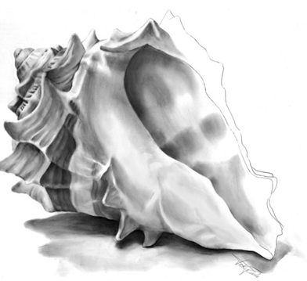
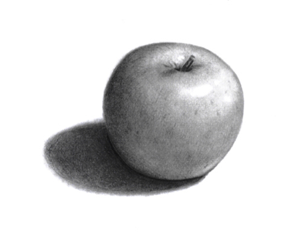
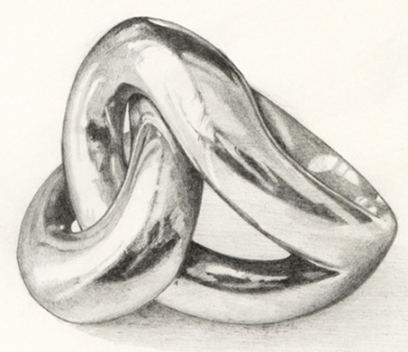
Form
Forms have 3-dimensions:
Height, width and DEPTH.
Forms are shapes with depth.
Artists can use shading (or value) when they draw forms to give them volume.
Like shapes, forms can be geometric or organic.

Slide 4
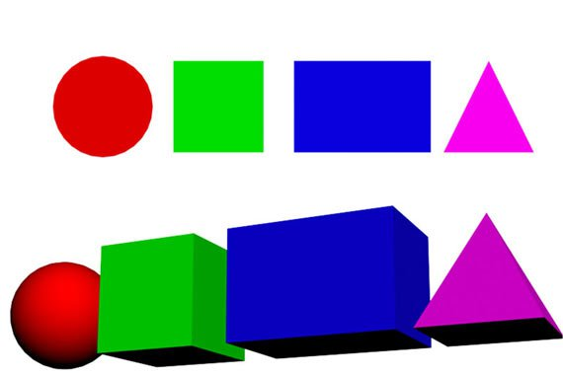
Shape Vs. Forms

Slide 5
Shape/Form & Photography
Shape is simply the 2D outline of an object or subject.
Form is similar to shape but has a 3D aspect created by light and shade. Form adds depth and volume to an image

Slide 6
Geometric Shapes/Forms

Slide 7
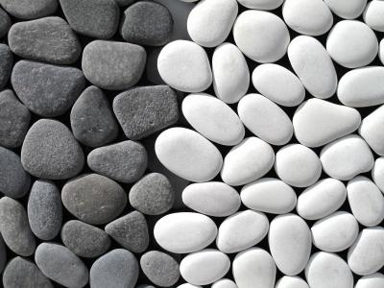
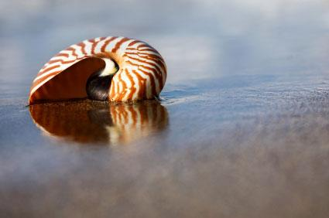
Organic
Shapes/Forms
Bug’s Eye View:
iPad/phone is placed directly on the ground

Slide 8
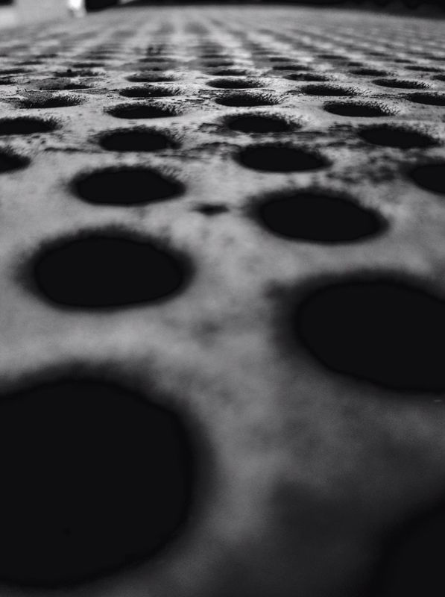
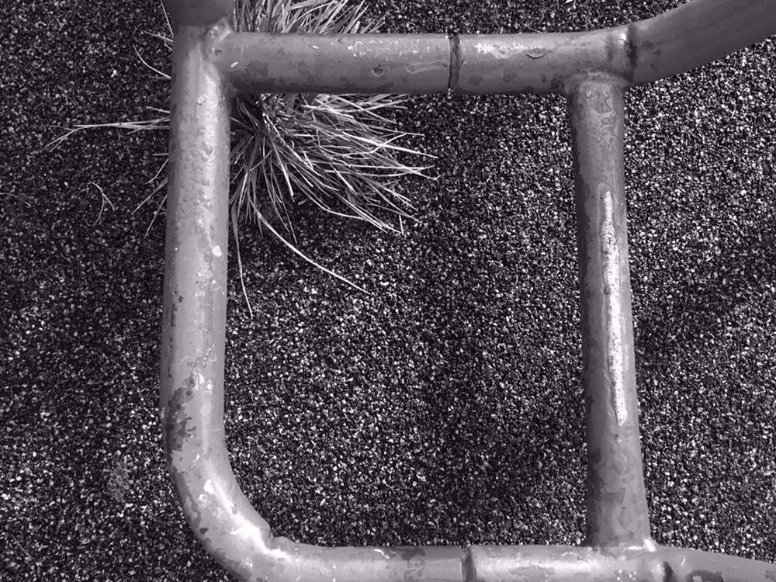
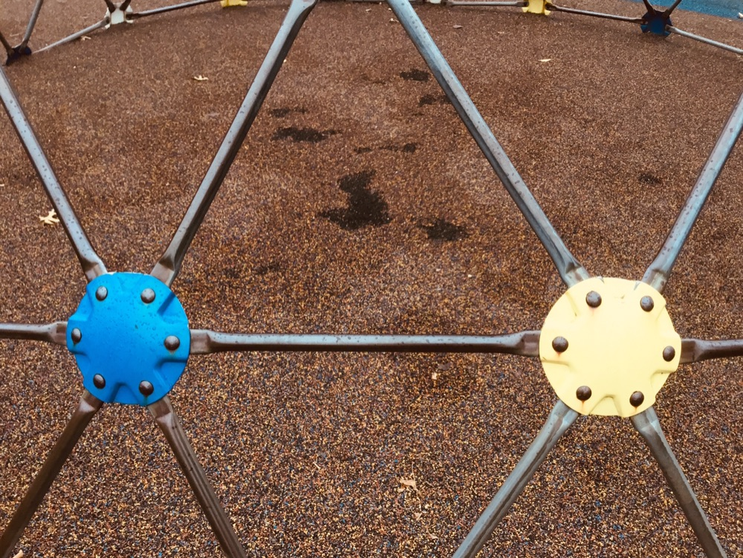
Shape/Form Student Examples

Slide 9
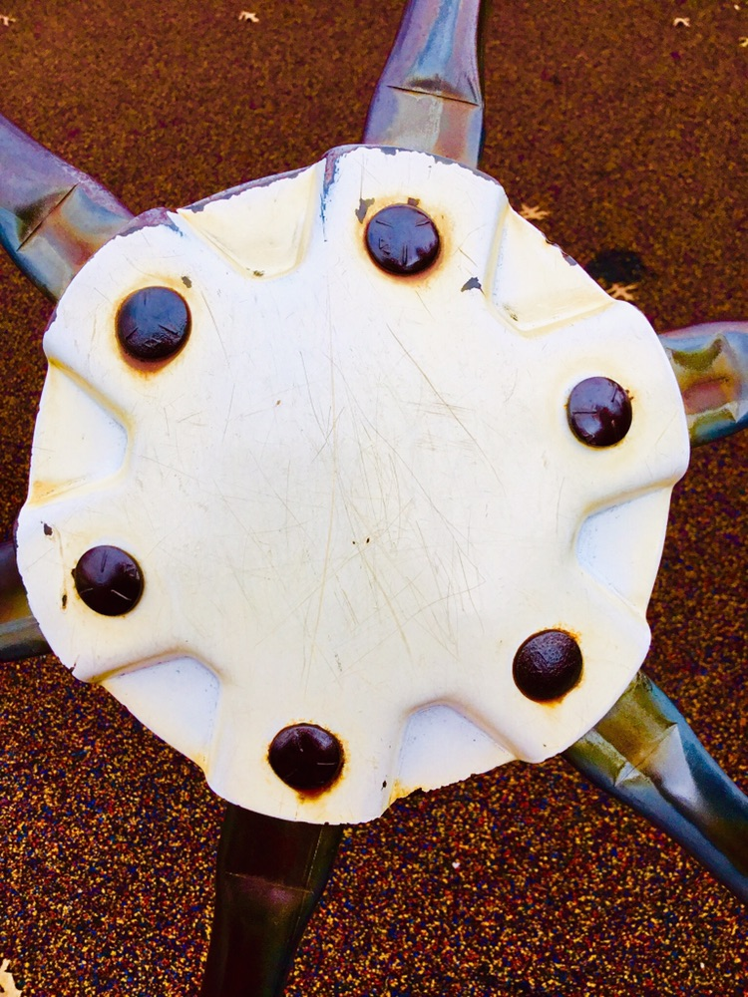
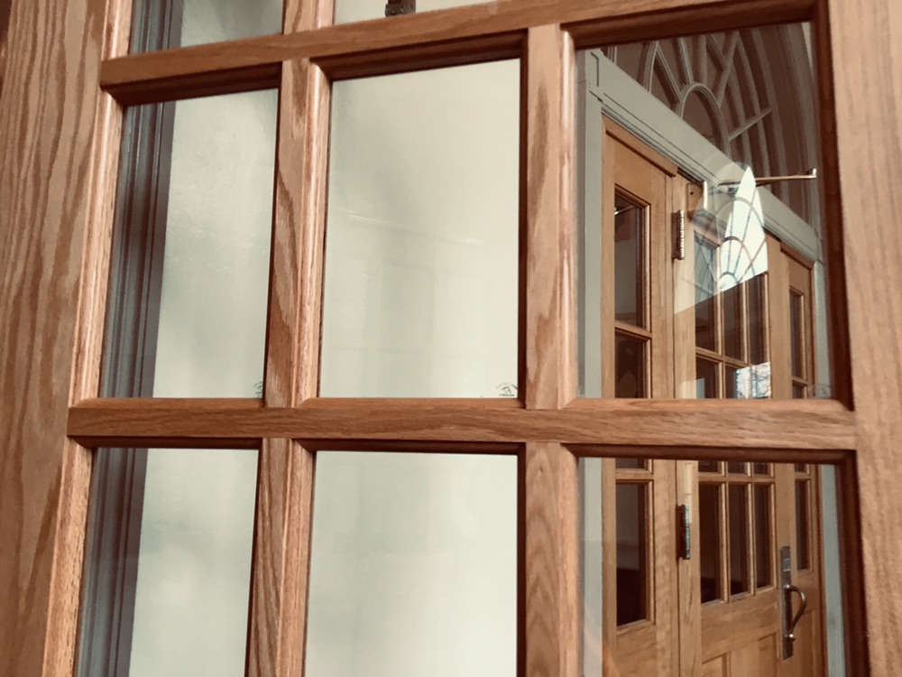
Shape/Form Student Examples

Slide 10
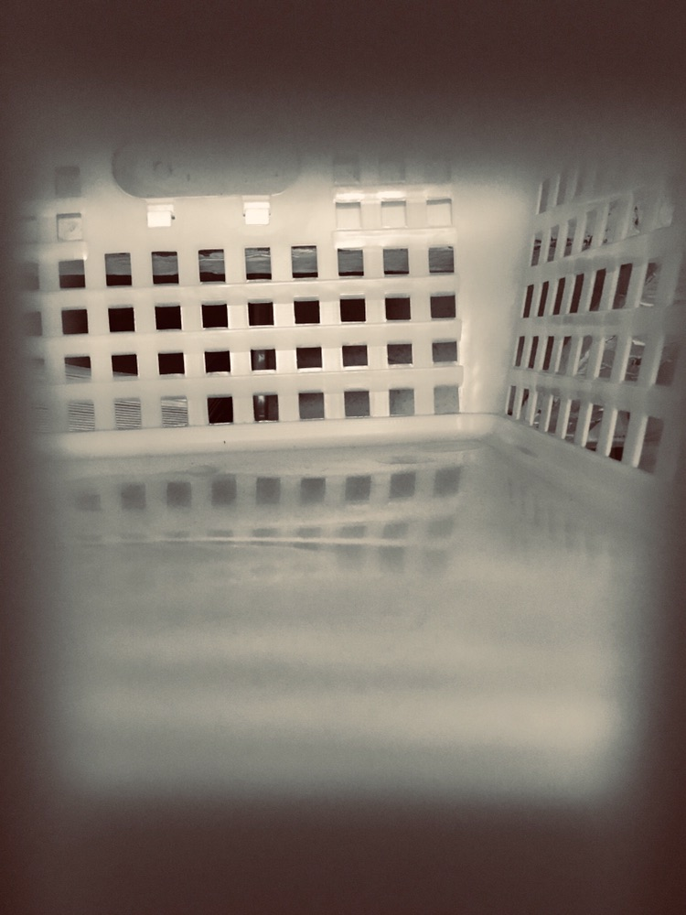
At Home Shape/Form Photography Challenge: Finding Geometric and Organic Shapes and Forms
Find 5 different shapes/forms to photograph and upload the images czellesartgarden@gmail.com(Due: May 13, 2020).

